Slide 1

Quick CAD Chassis Design
GW Robotics

Slide 2
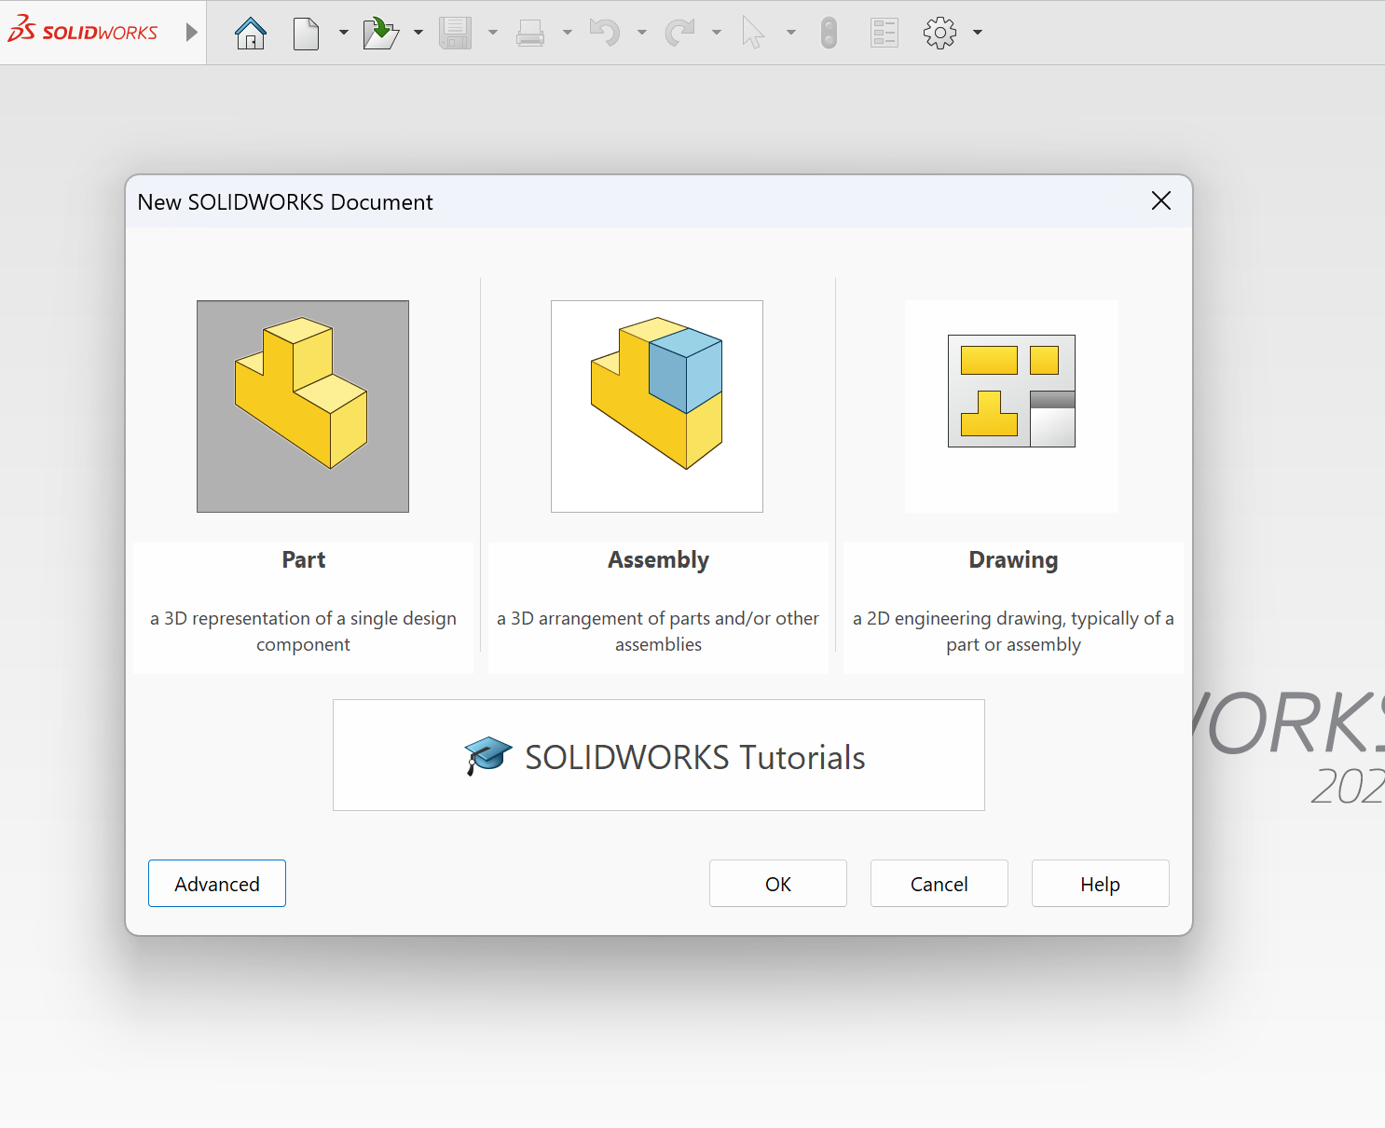
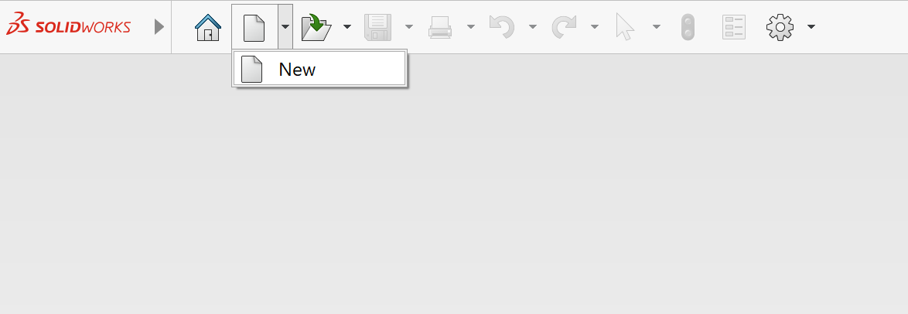
Choose Part

Slide 3
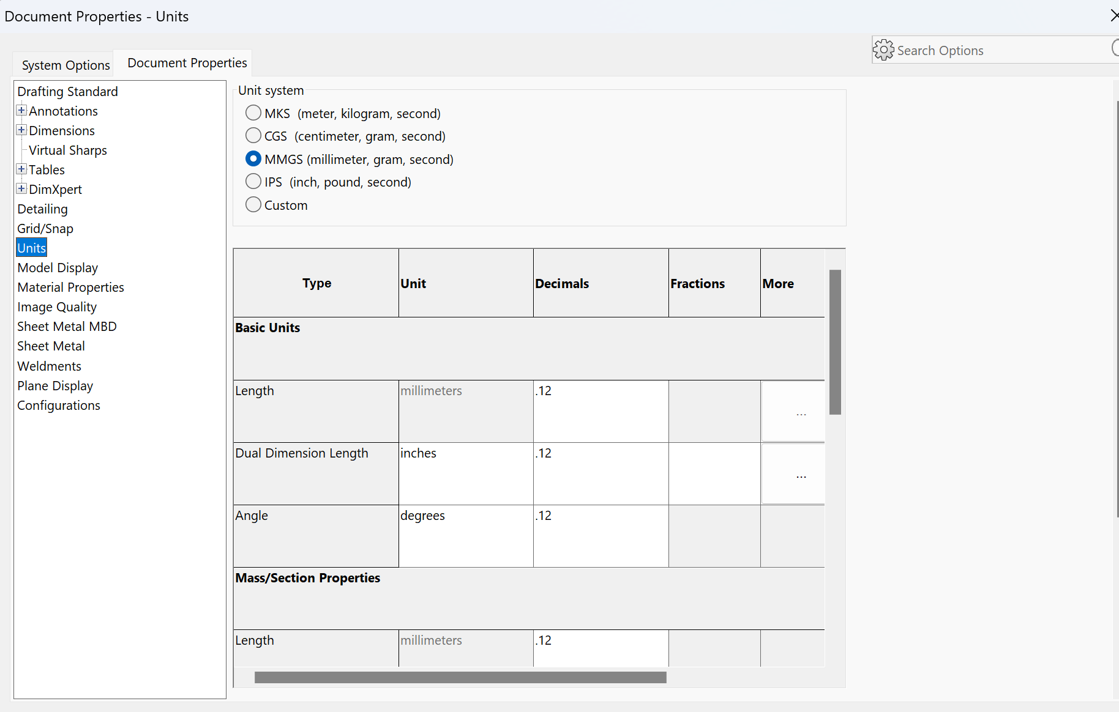
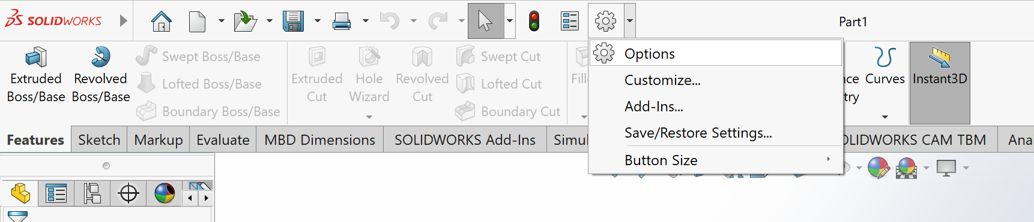
Check Units

Slide 4
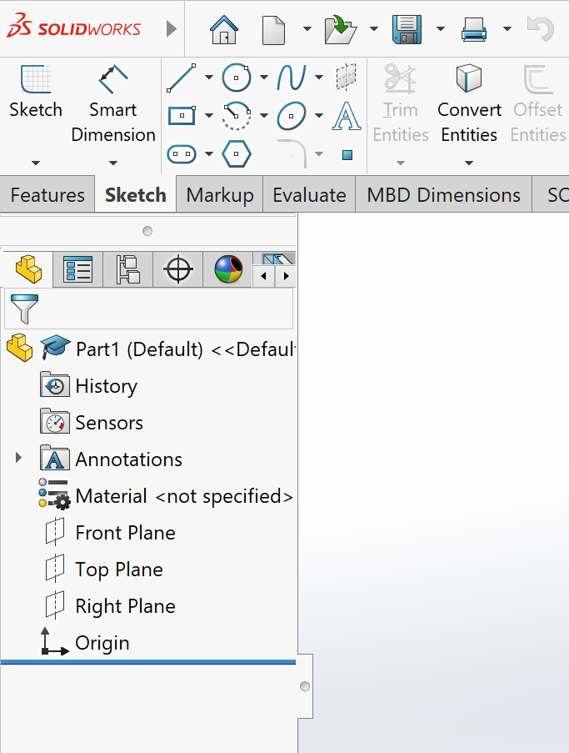
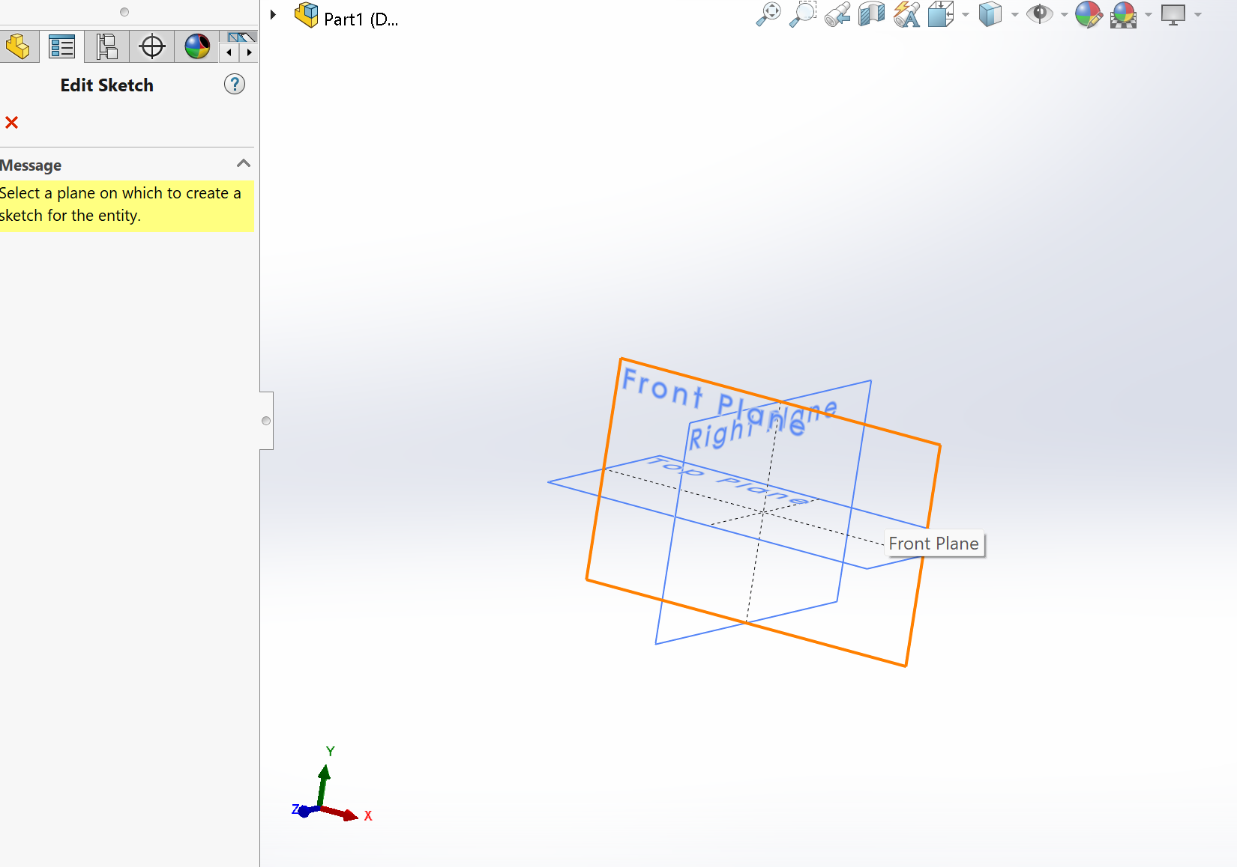
Sketch Tab
Click Sketch and select Front Plane

Slide 5
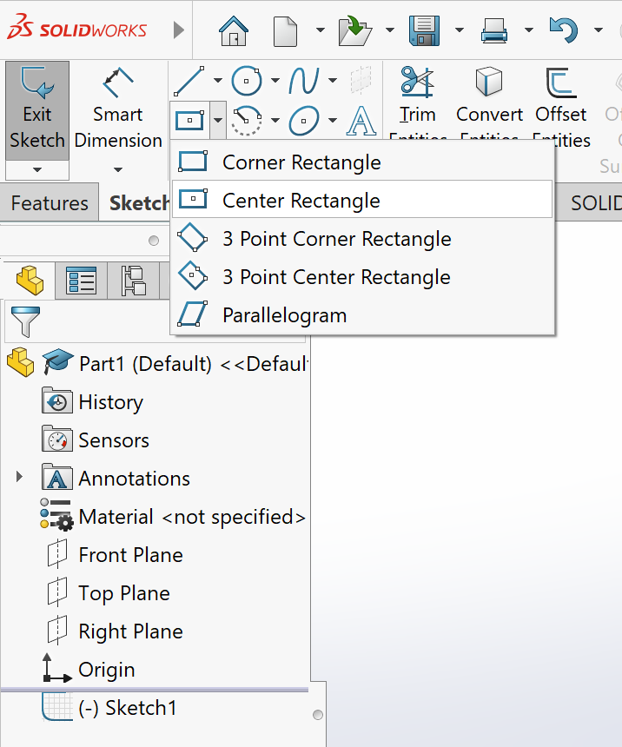
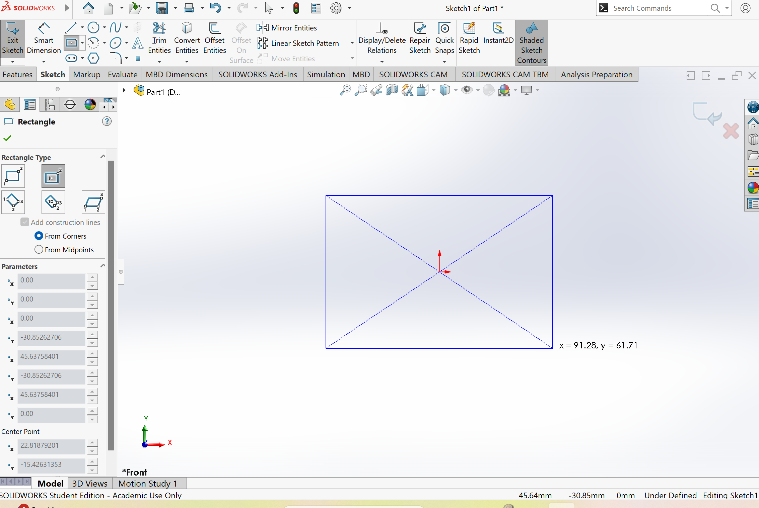
Select Rectangle tool
Center Rectangle and place it at origin

Slide 6
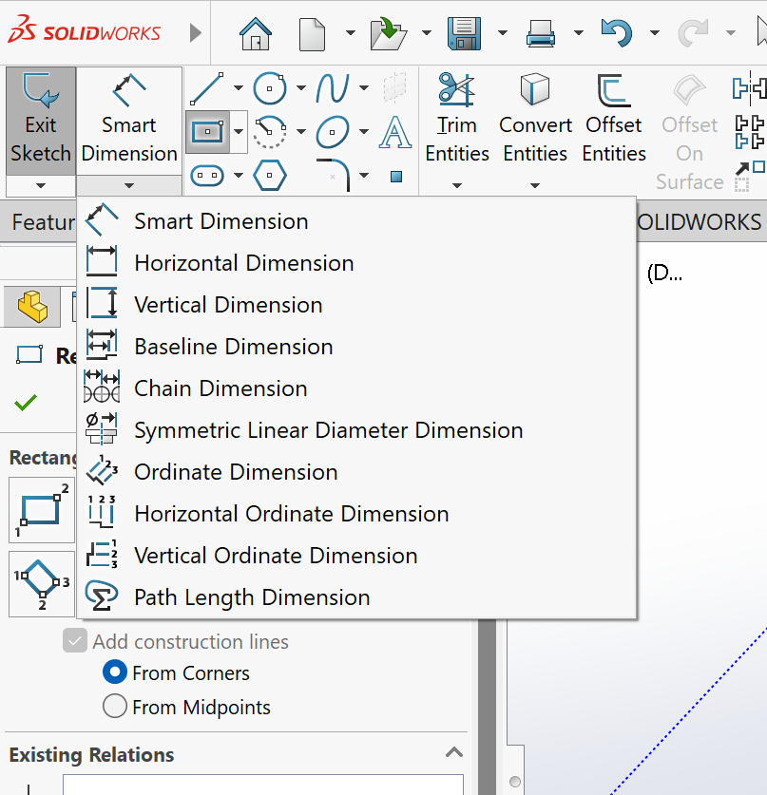
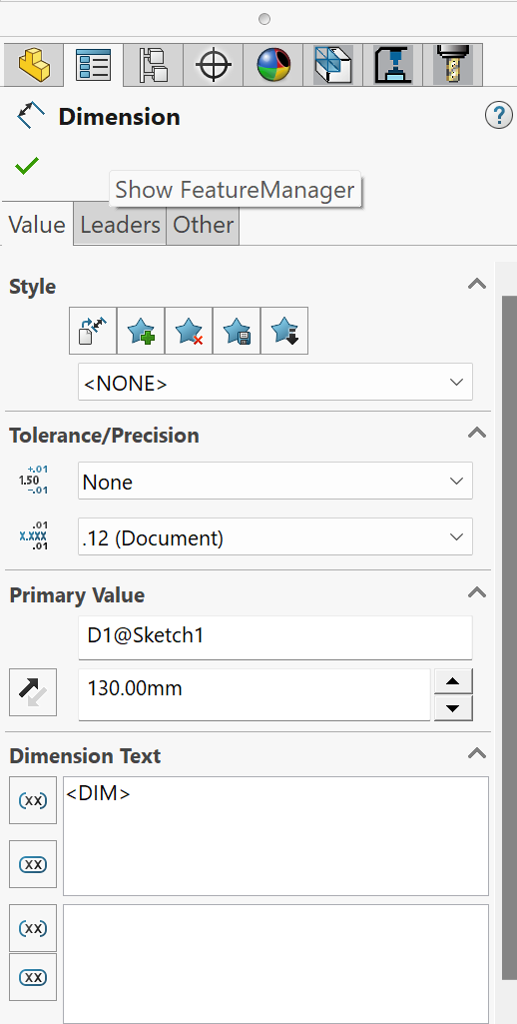
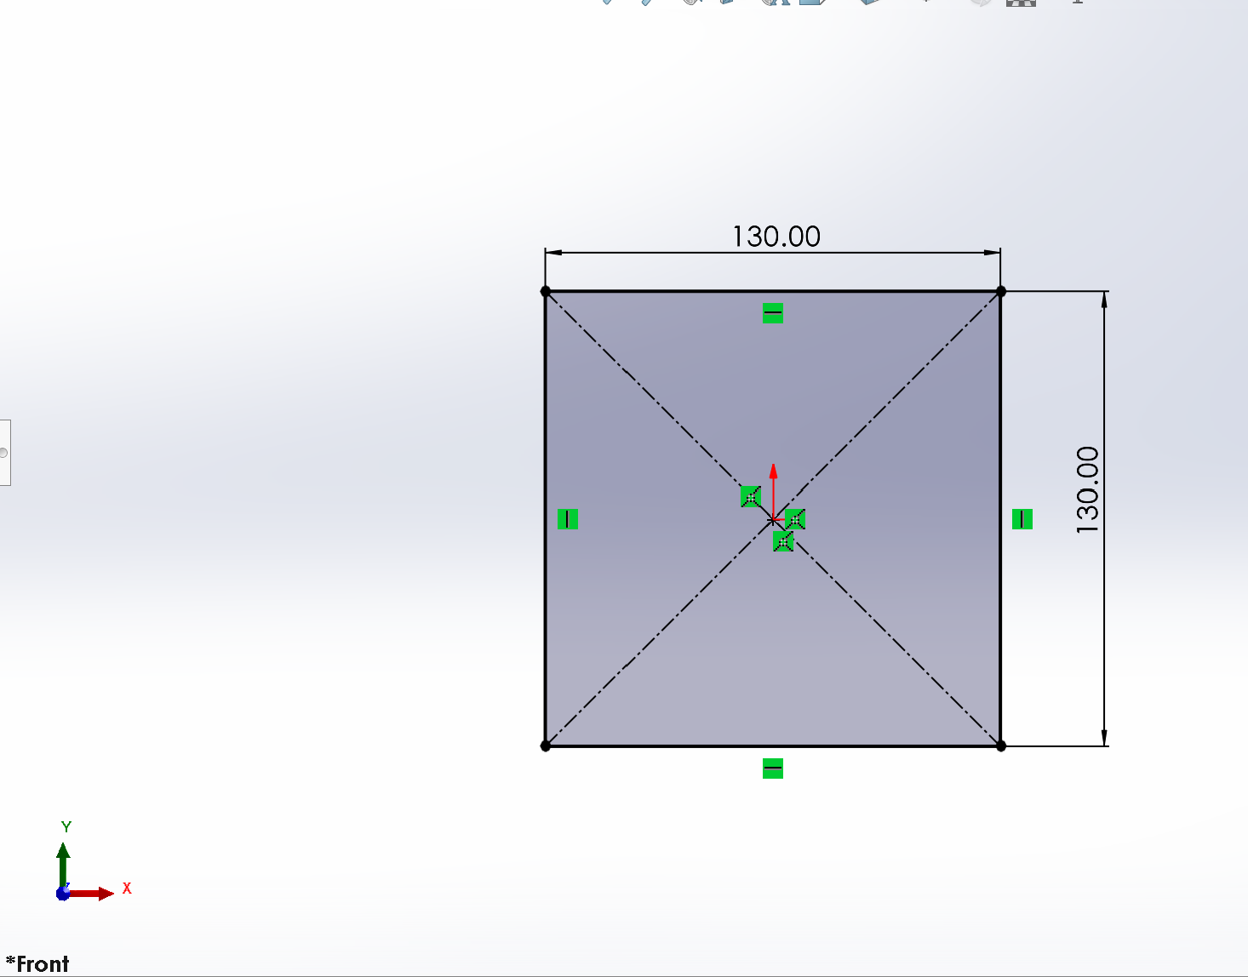
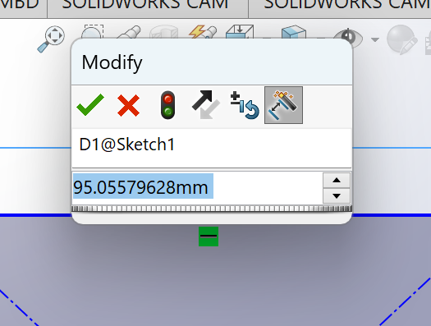
Dimension
Choose smart dimension or Horizontal/Vertical dimension
Click on lines you want to dimension.
You can change dimension from the dimension panel and double clicking the dimension lines

Slide 7
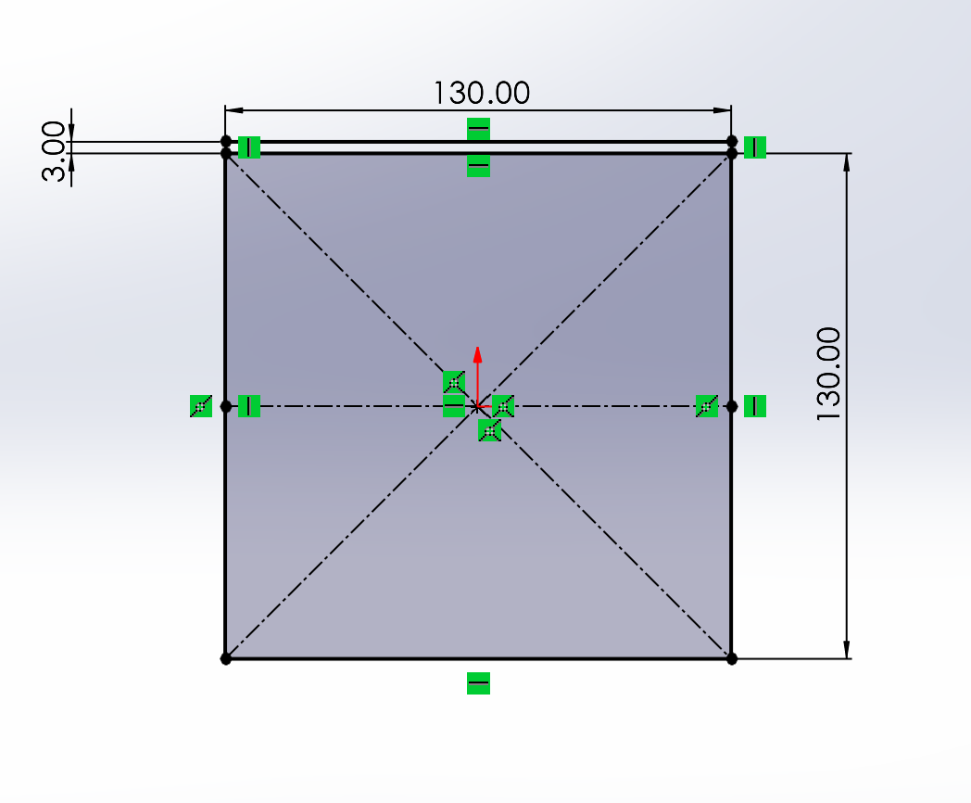
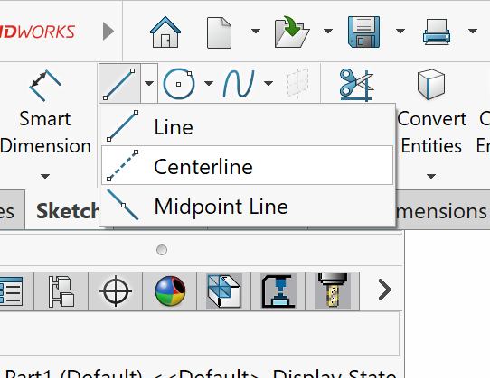
Centerline
Draw 3 line at the top
Draw a centerline

Slide 8
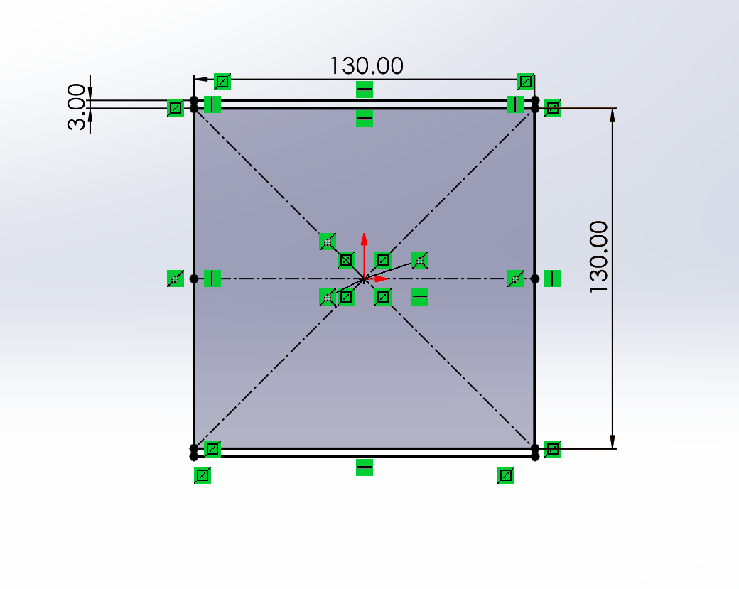
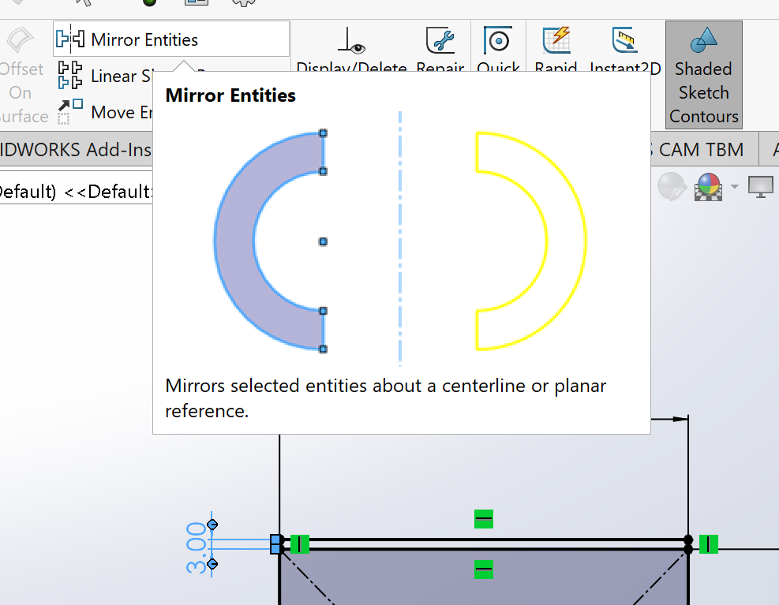
Mirror Entities
Check the relation by changing the thickness dimension

Slide 9
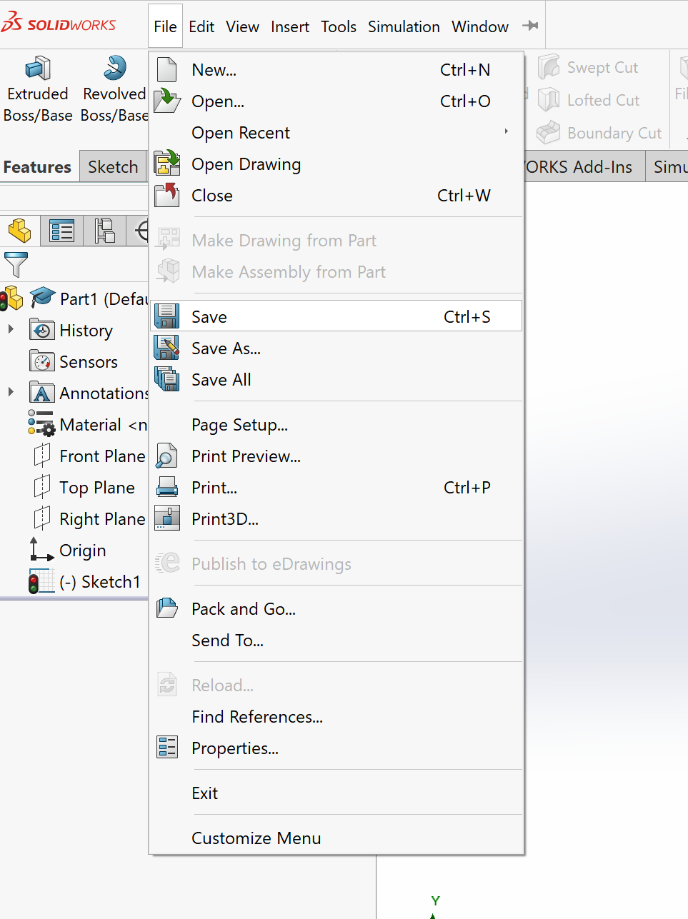
Save you file

Slide 10
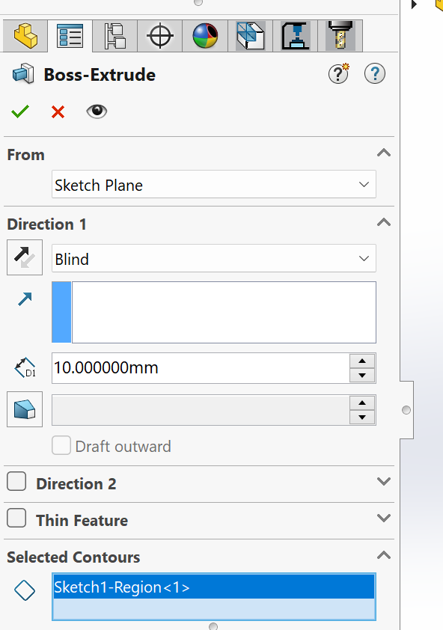
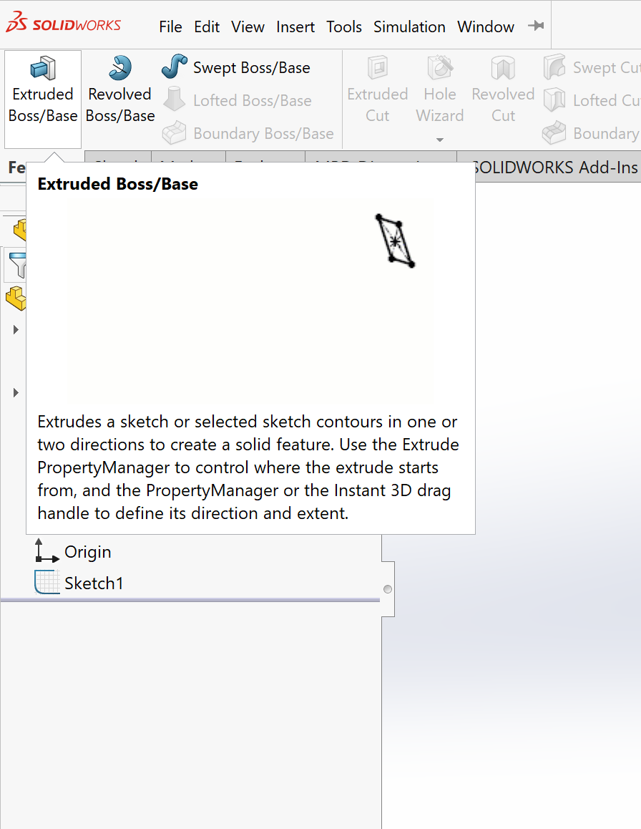
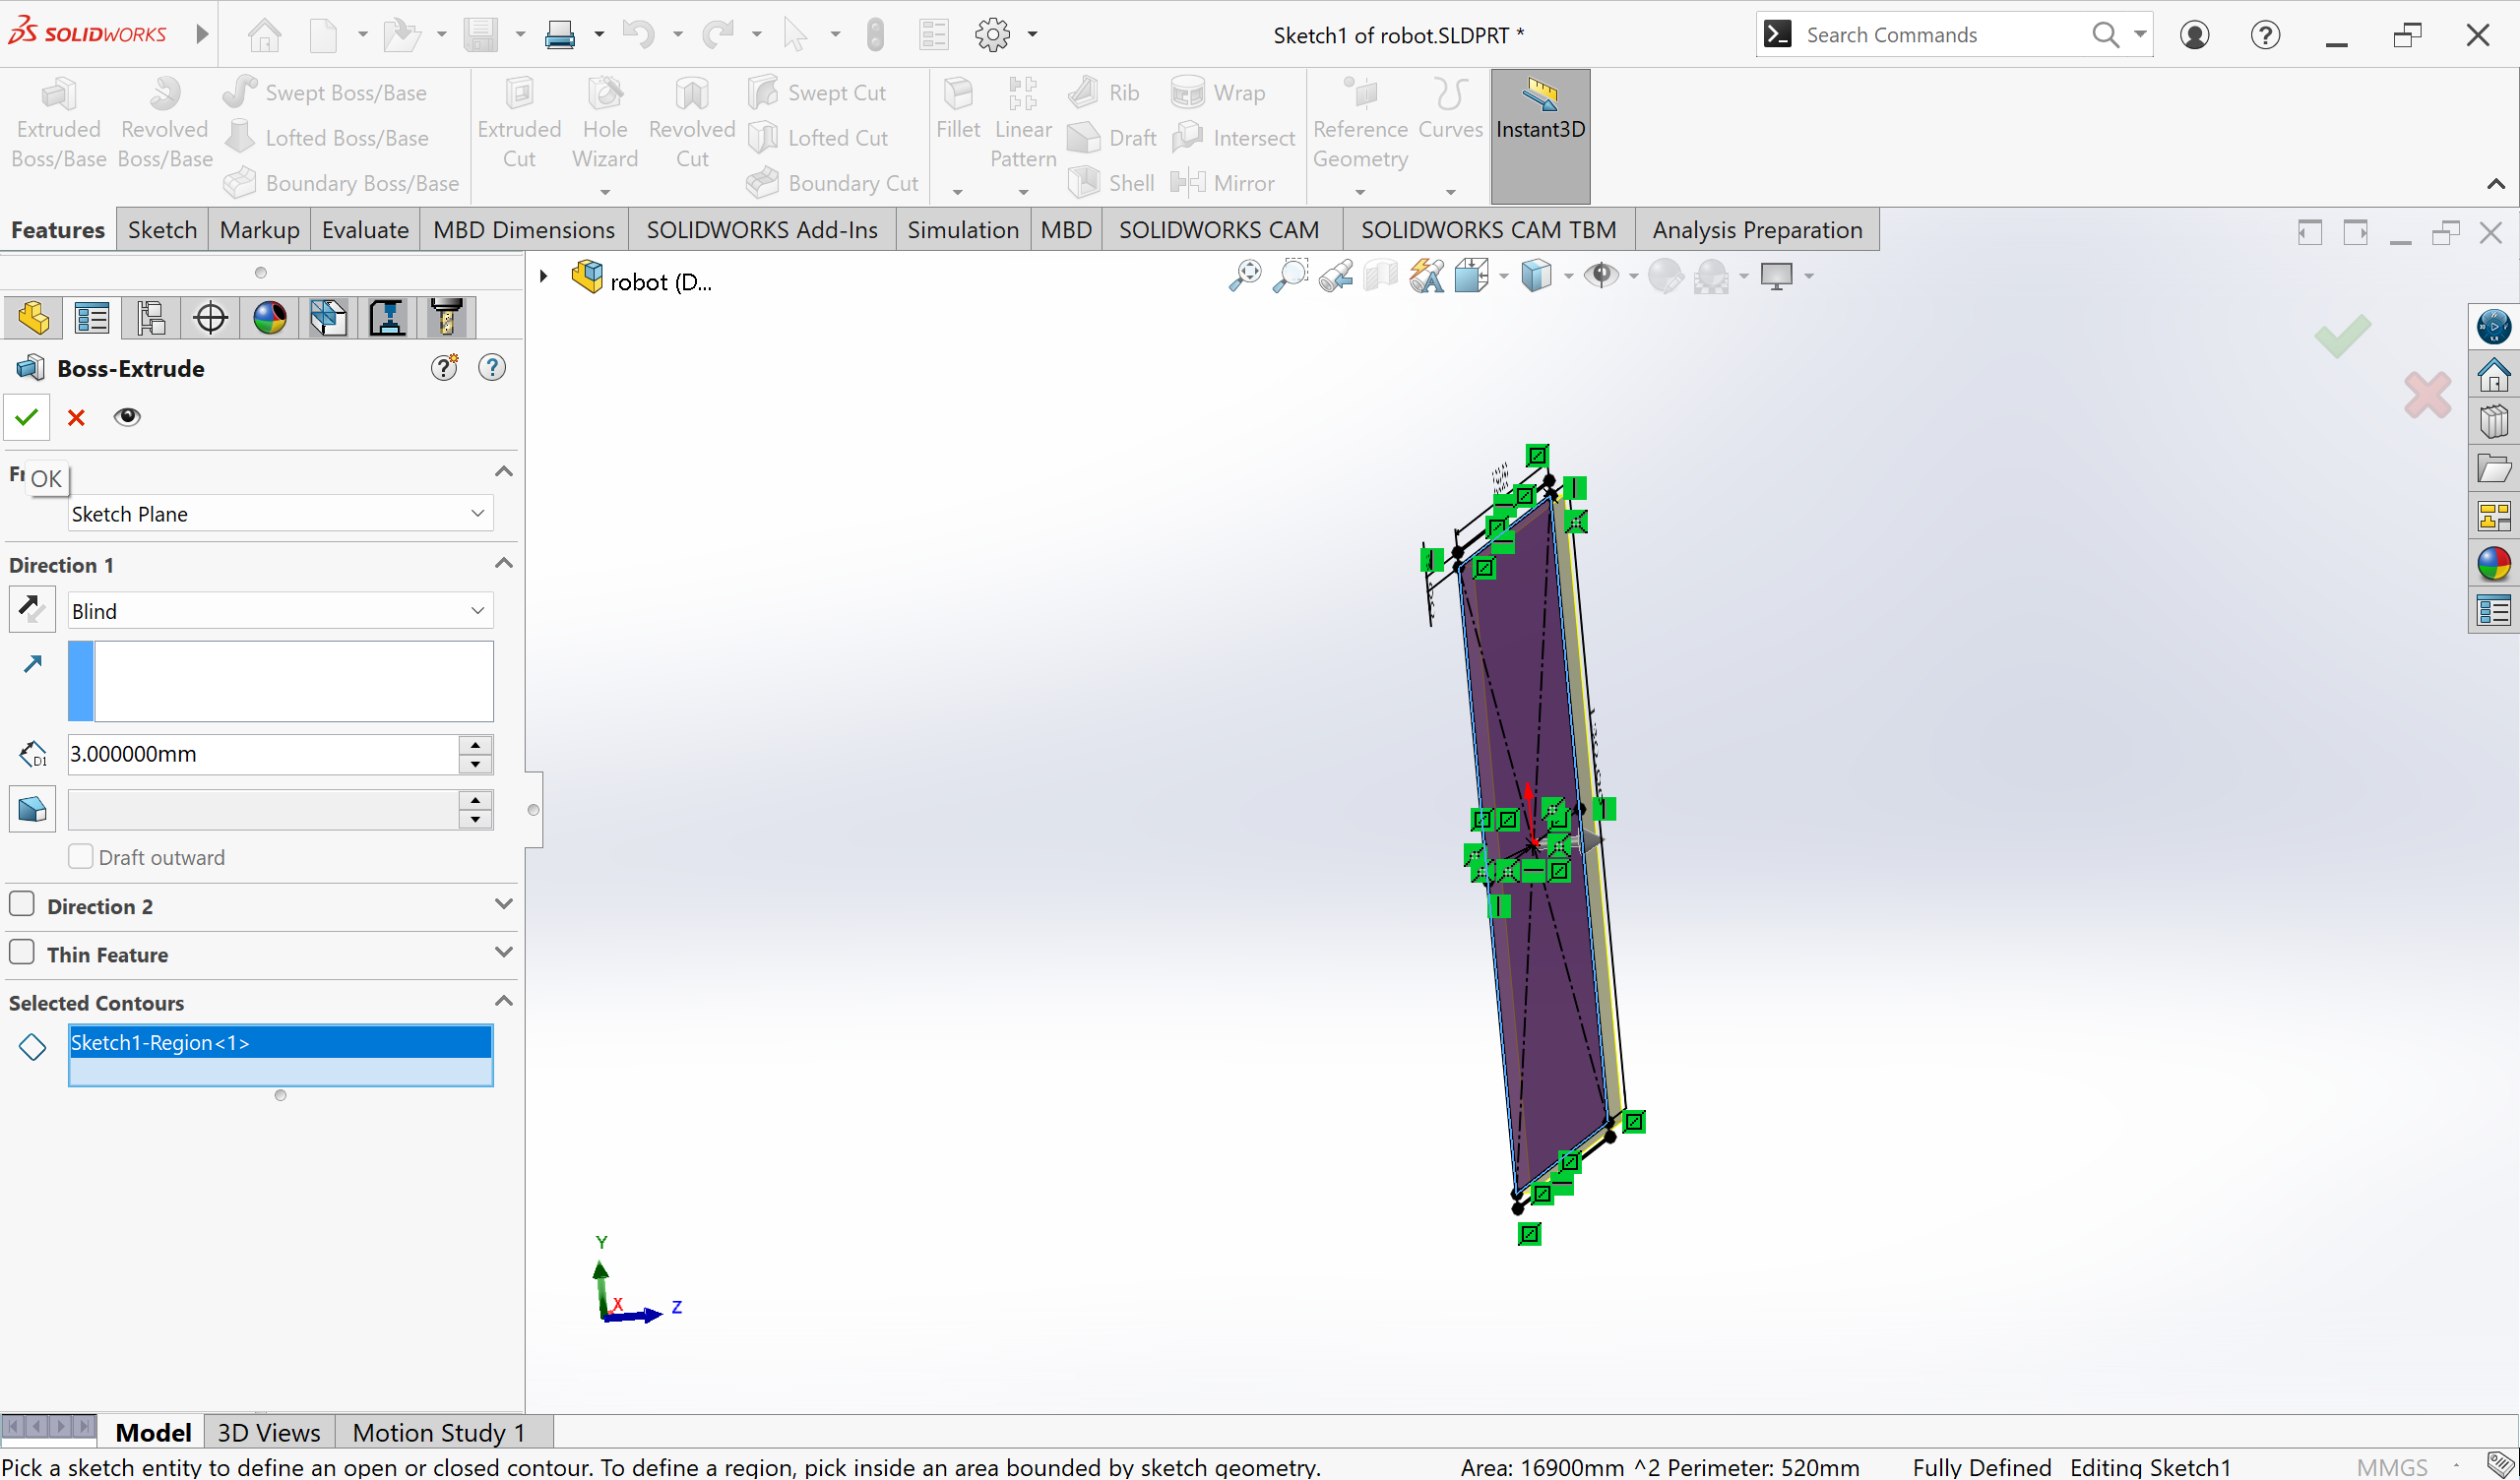
Features -> Extrude -> choose thickness -> Click Ok

Slide 11
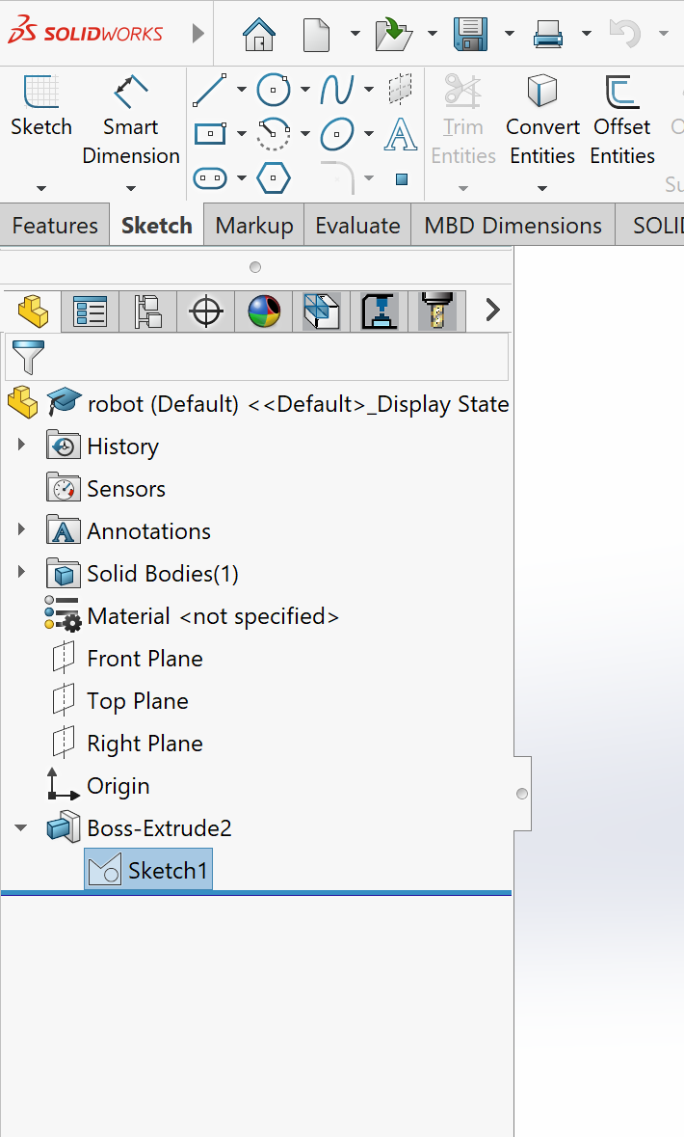
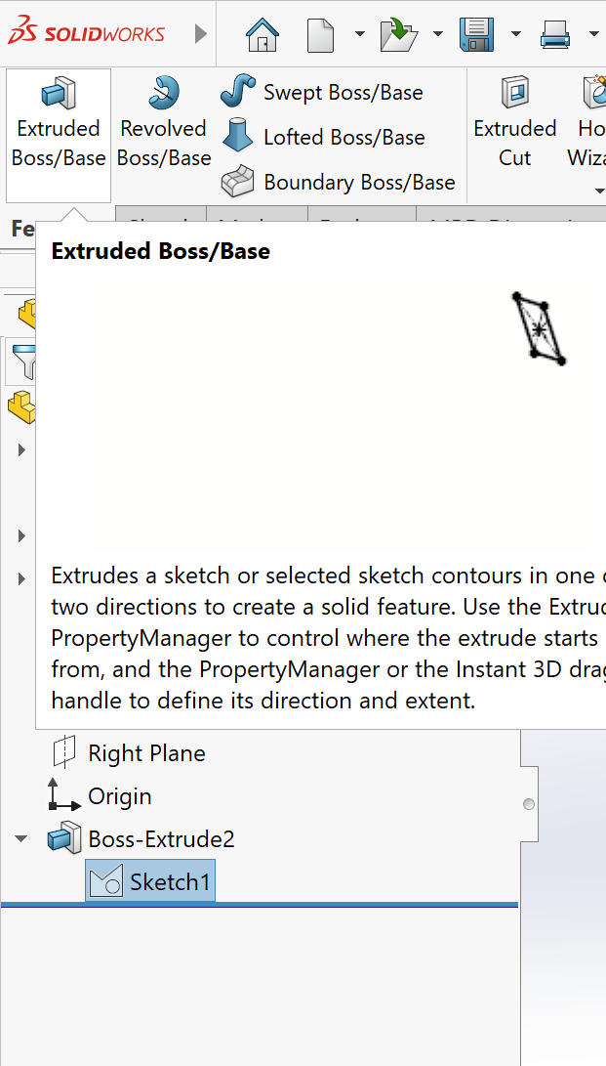
Select Sketch 1 -> Go to Features and Select extrude

Slide 12
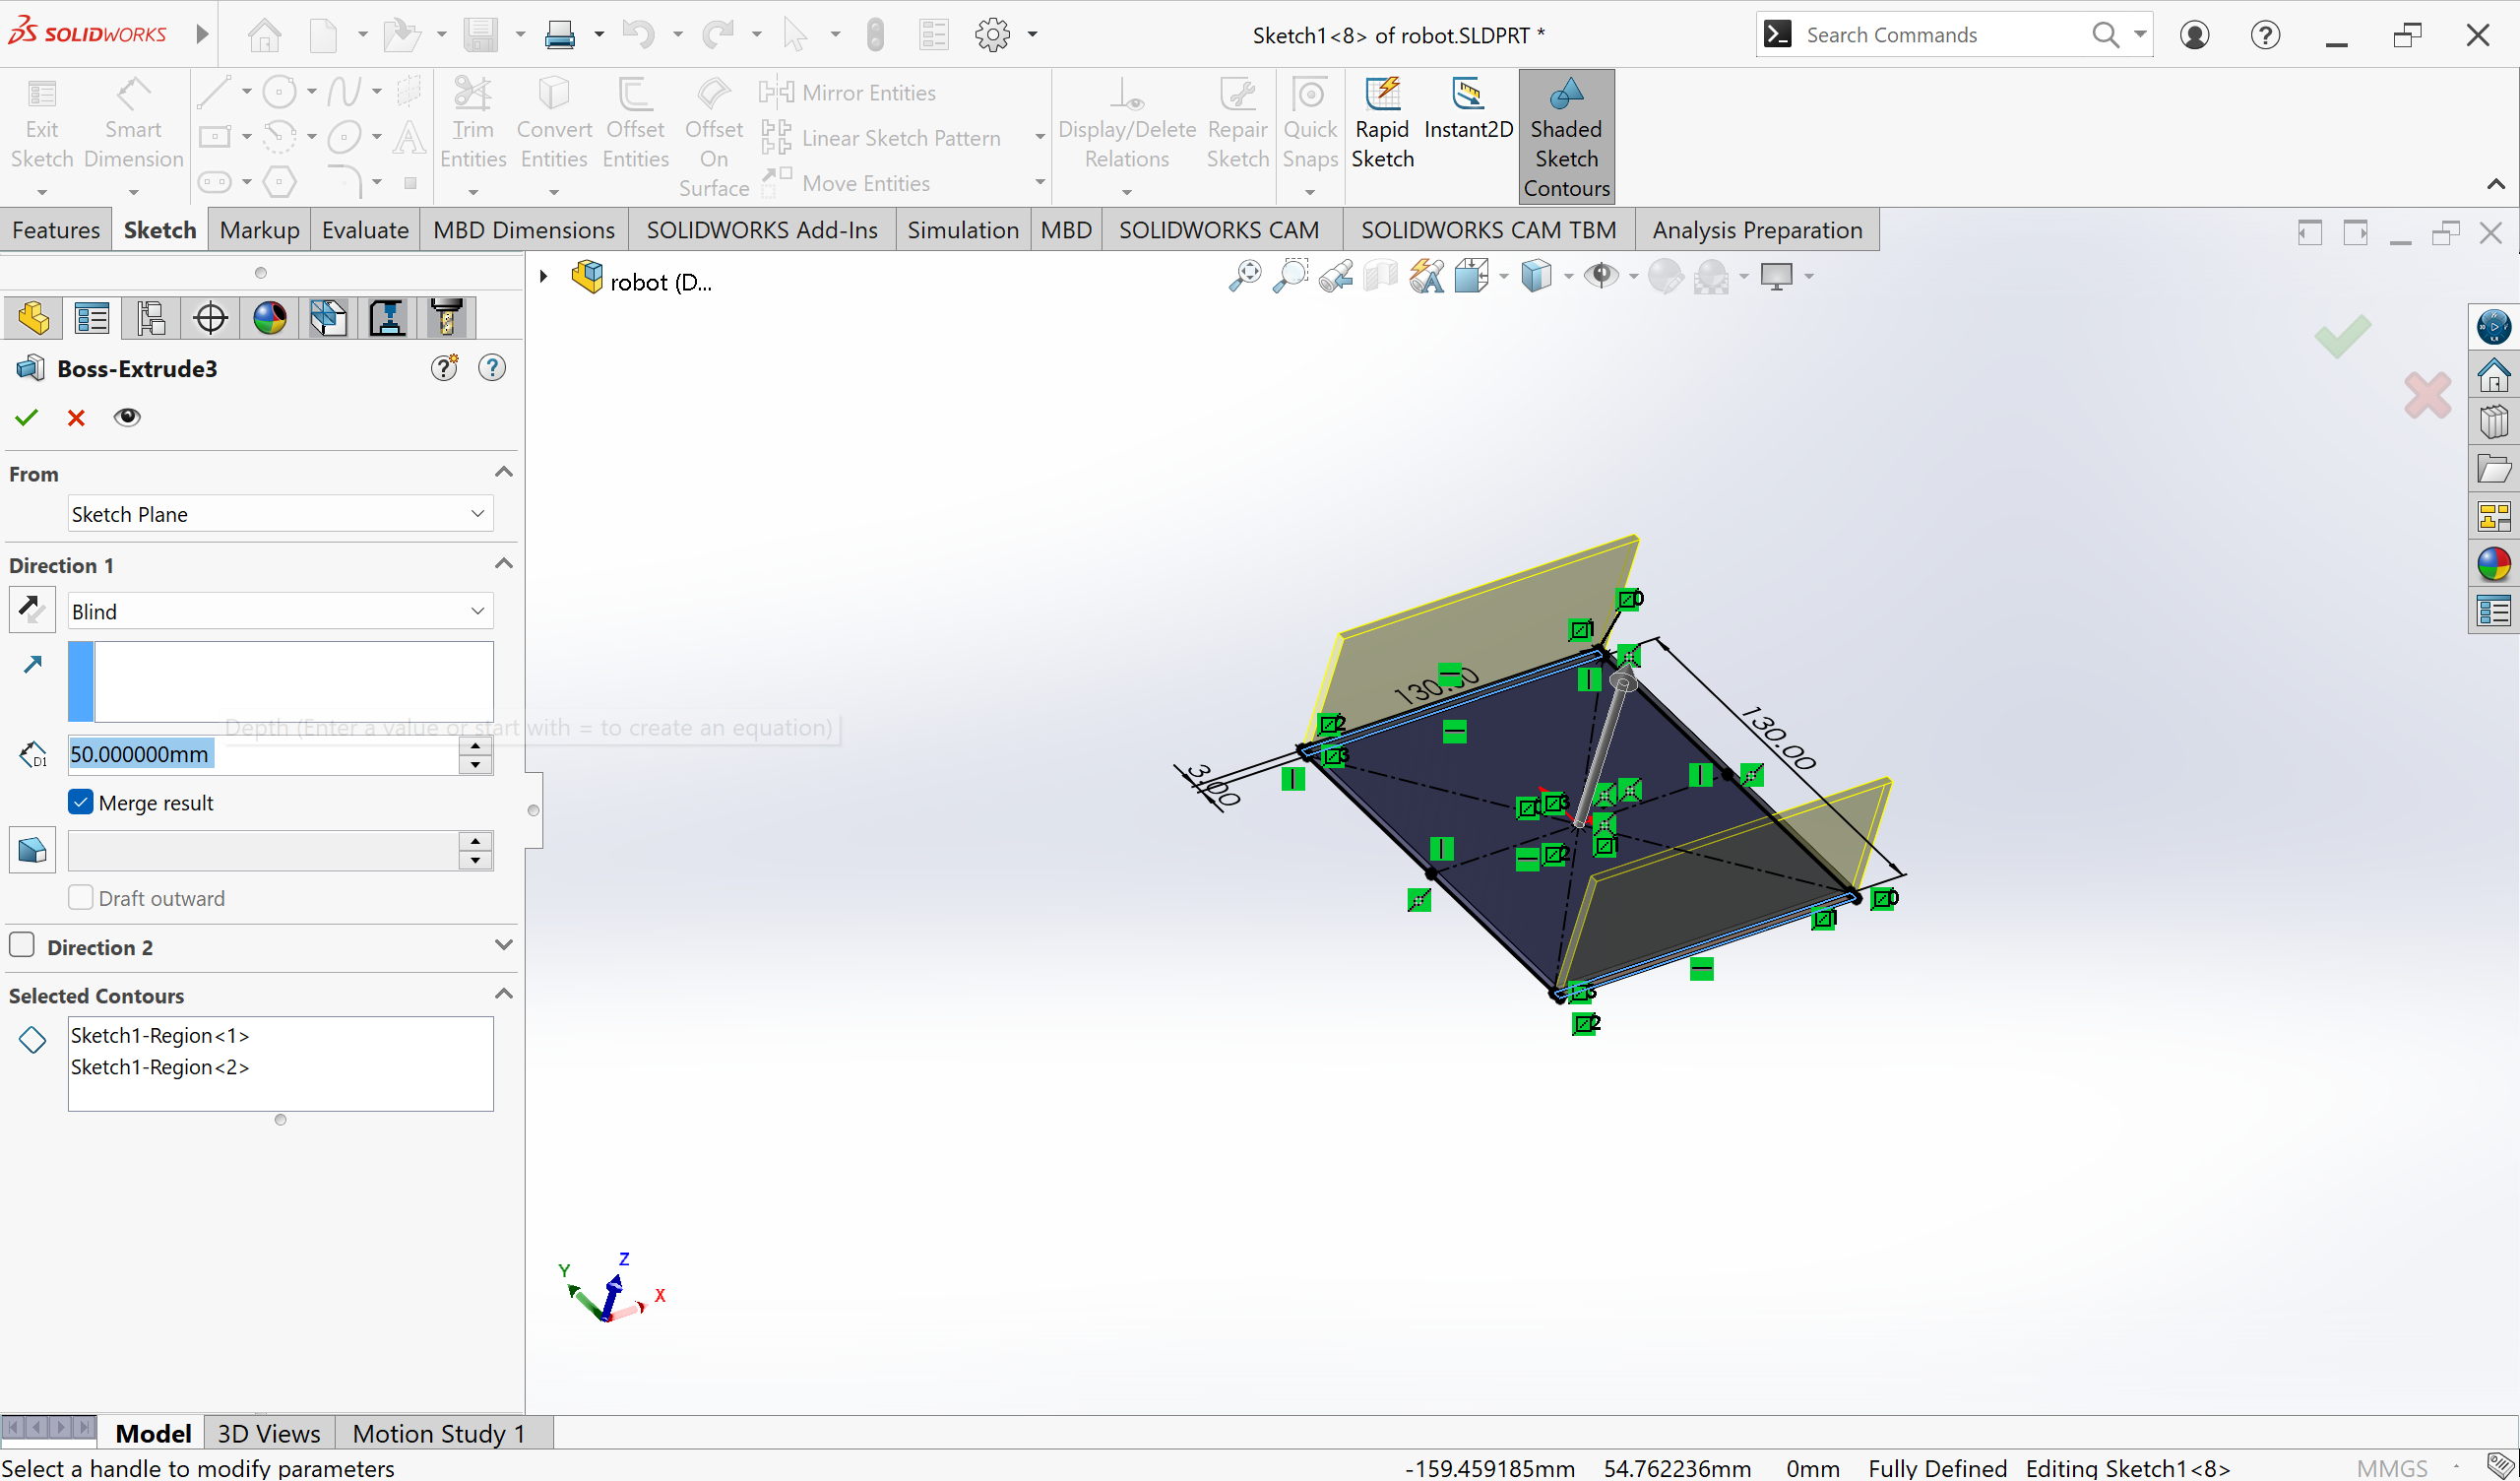
Now extrude the sides to 50 mm-> Click ok

Slide 13
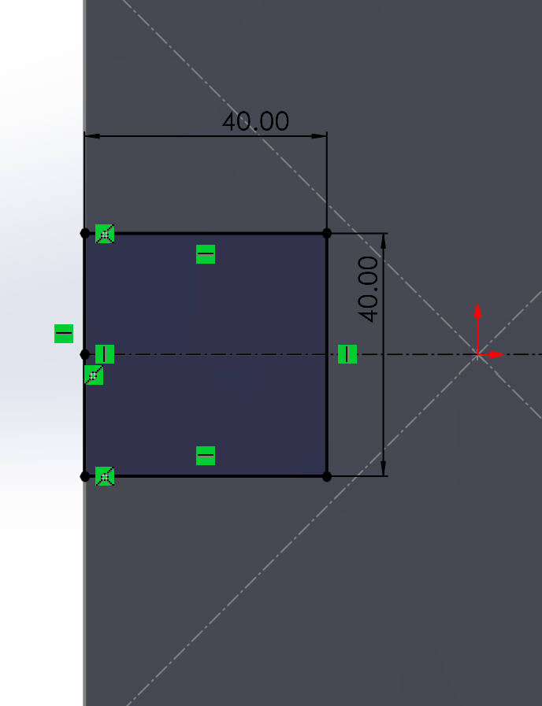
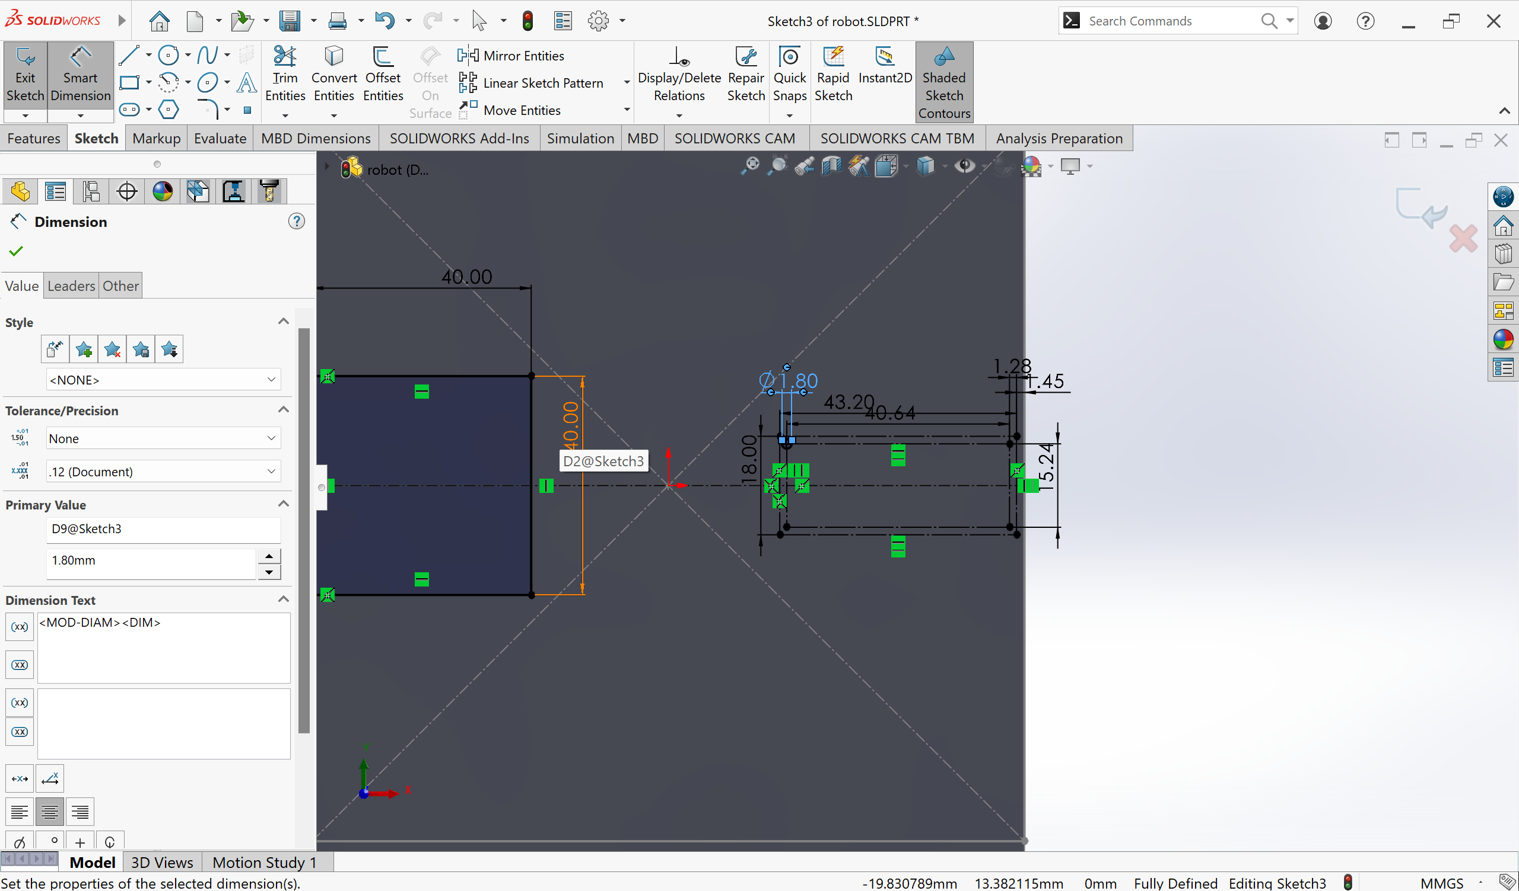
Draw

Slide 14
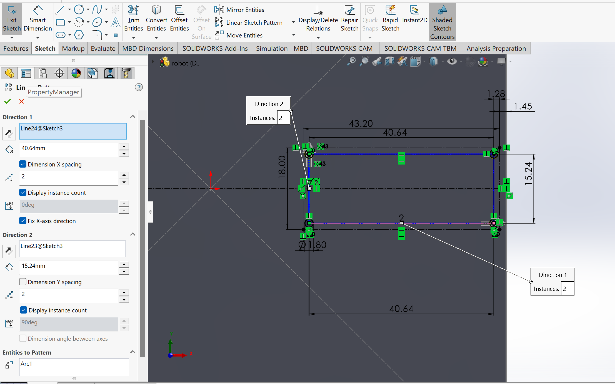
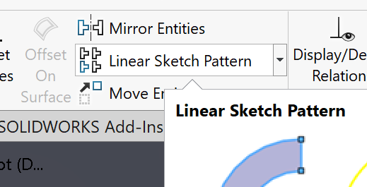
Linear Sketch Pattern

Slide 15


Slide 16
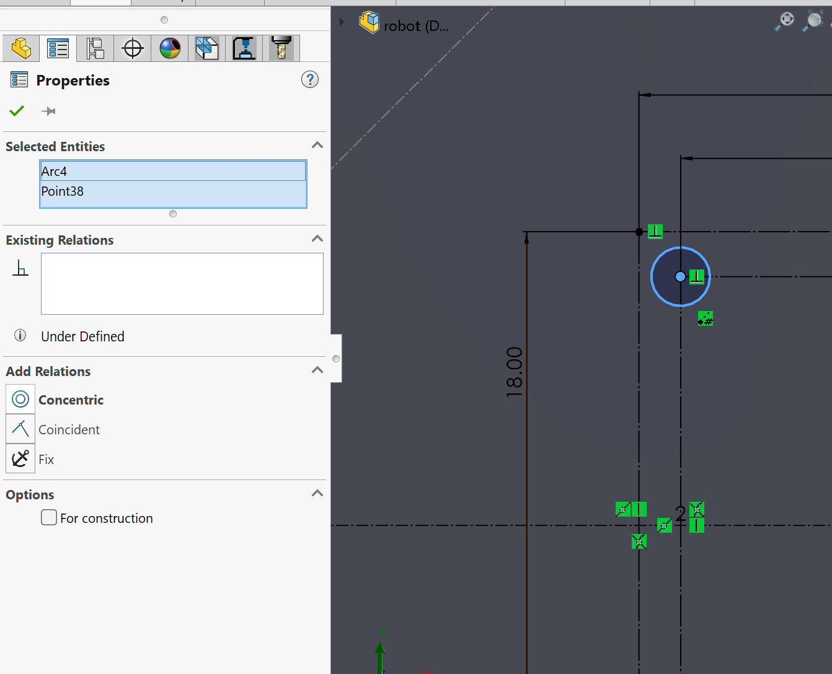
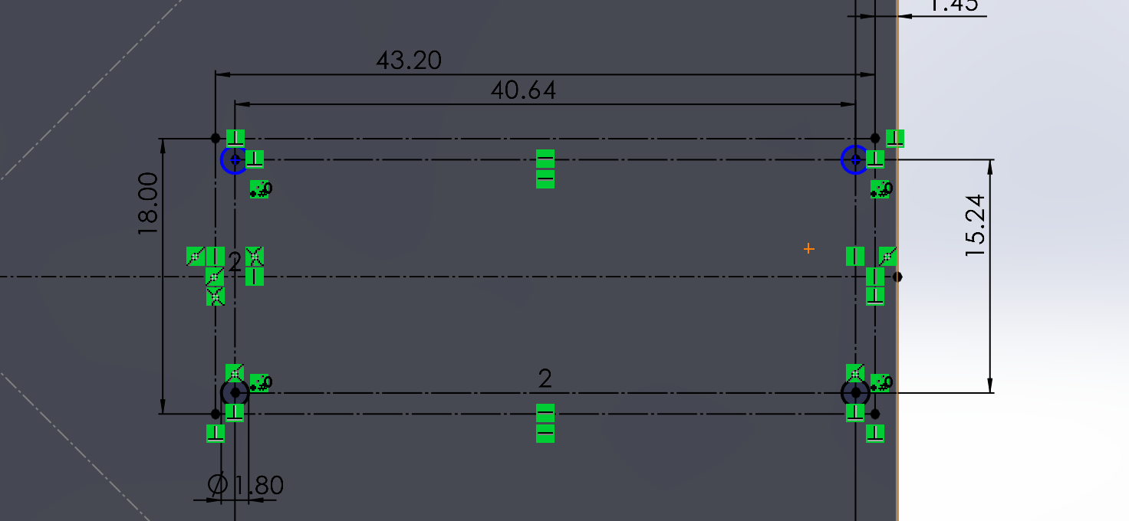
Fix Blue circles - Concentric

Slide 17
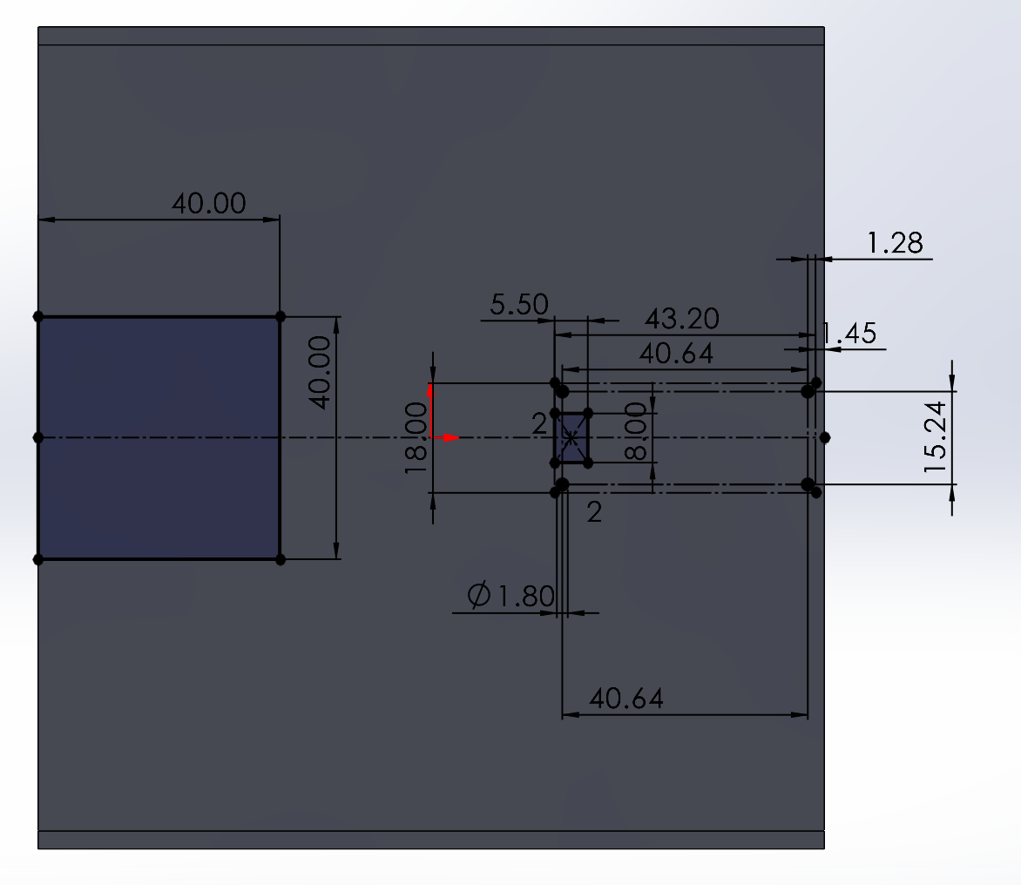
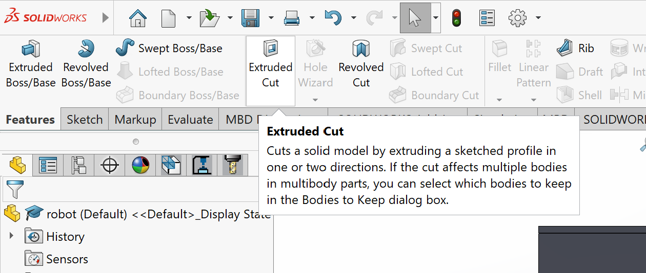
Draw something like this and extrude cut

Slide 18
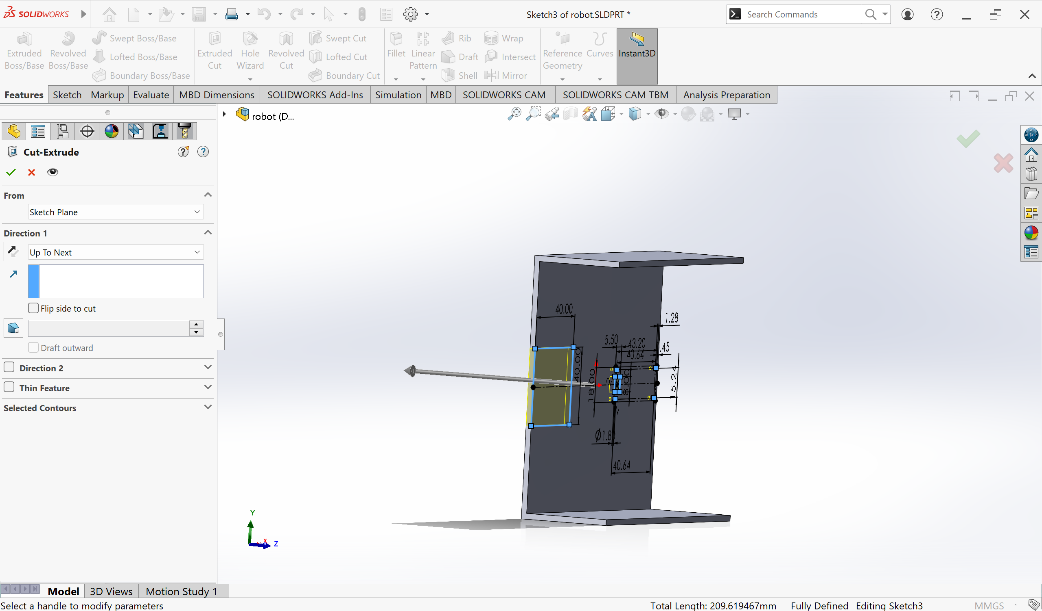
Cut Extrude - Up to Next

Slide 19
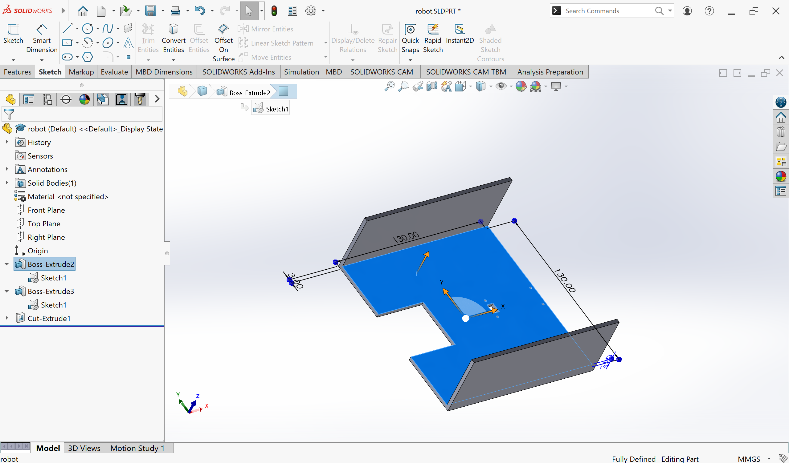
Another sketch

Slide 20
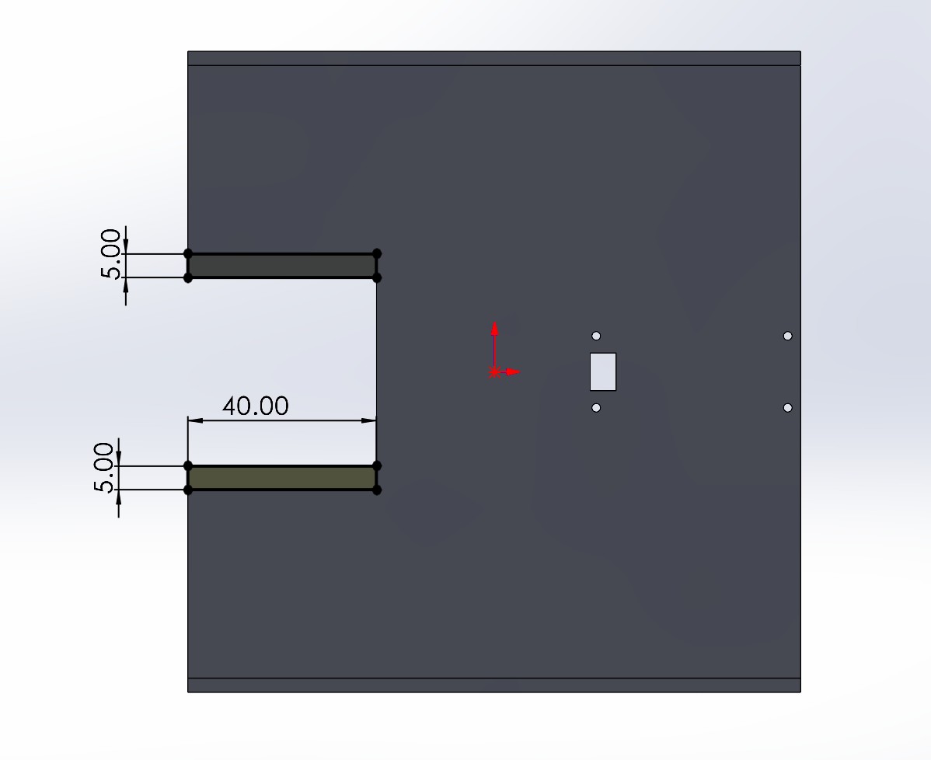
Draw this

Slide 21
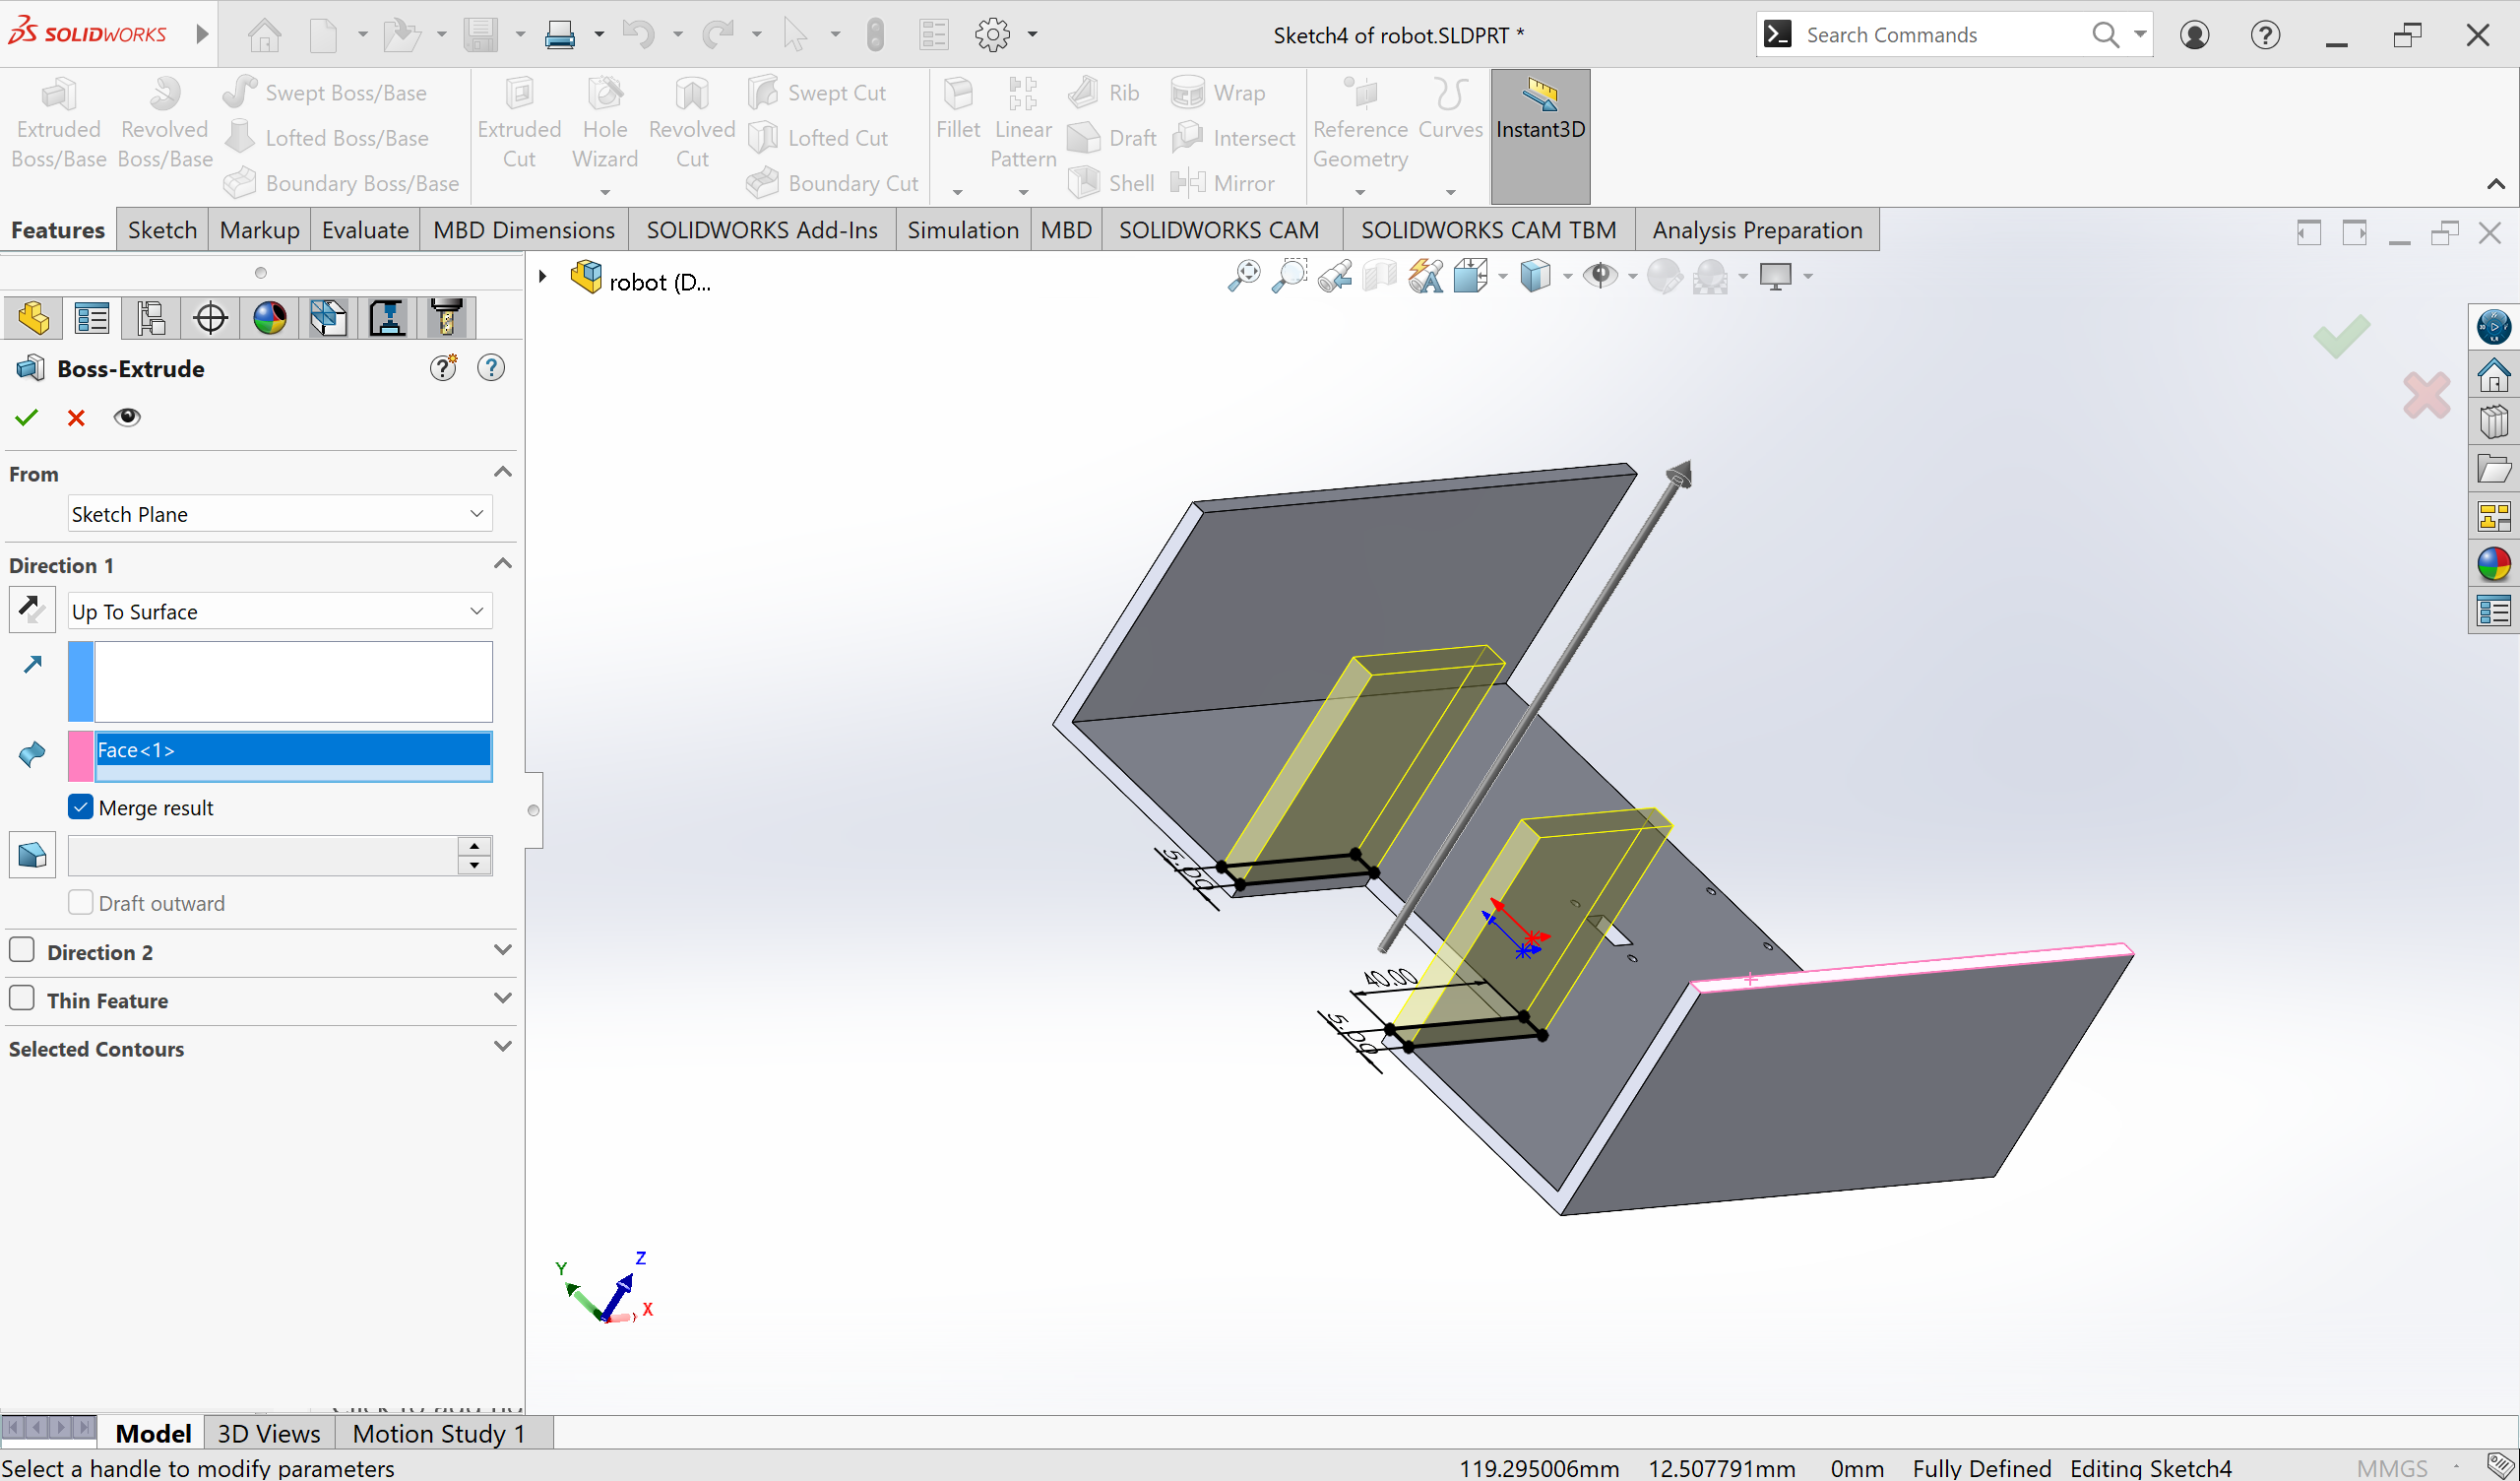
Extrude- Up to surface

Slide 22
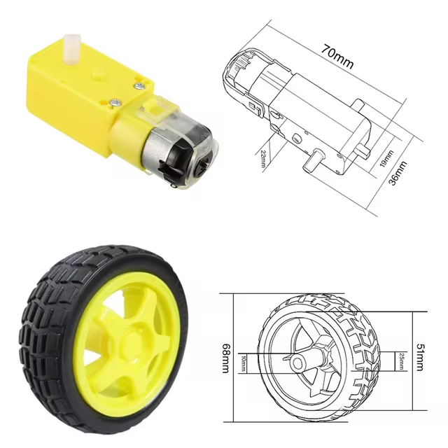
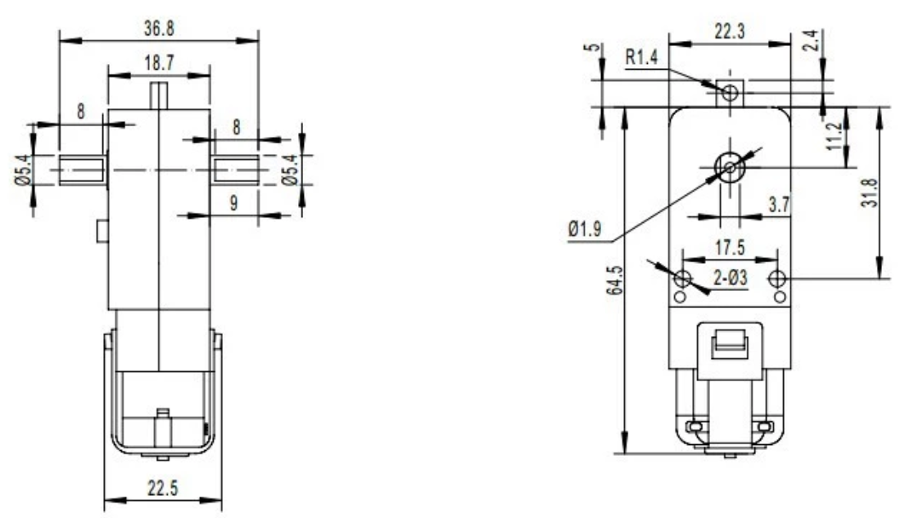

Slide 23
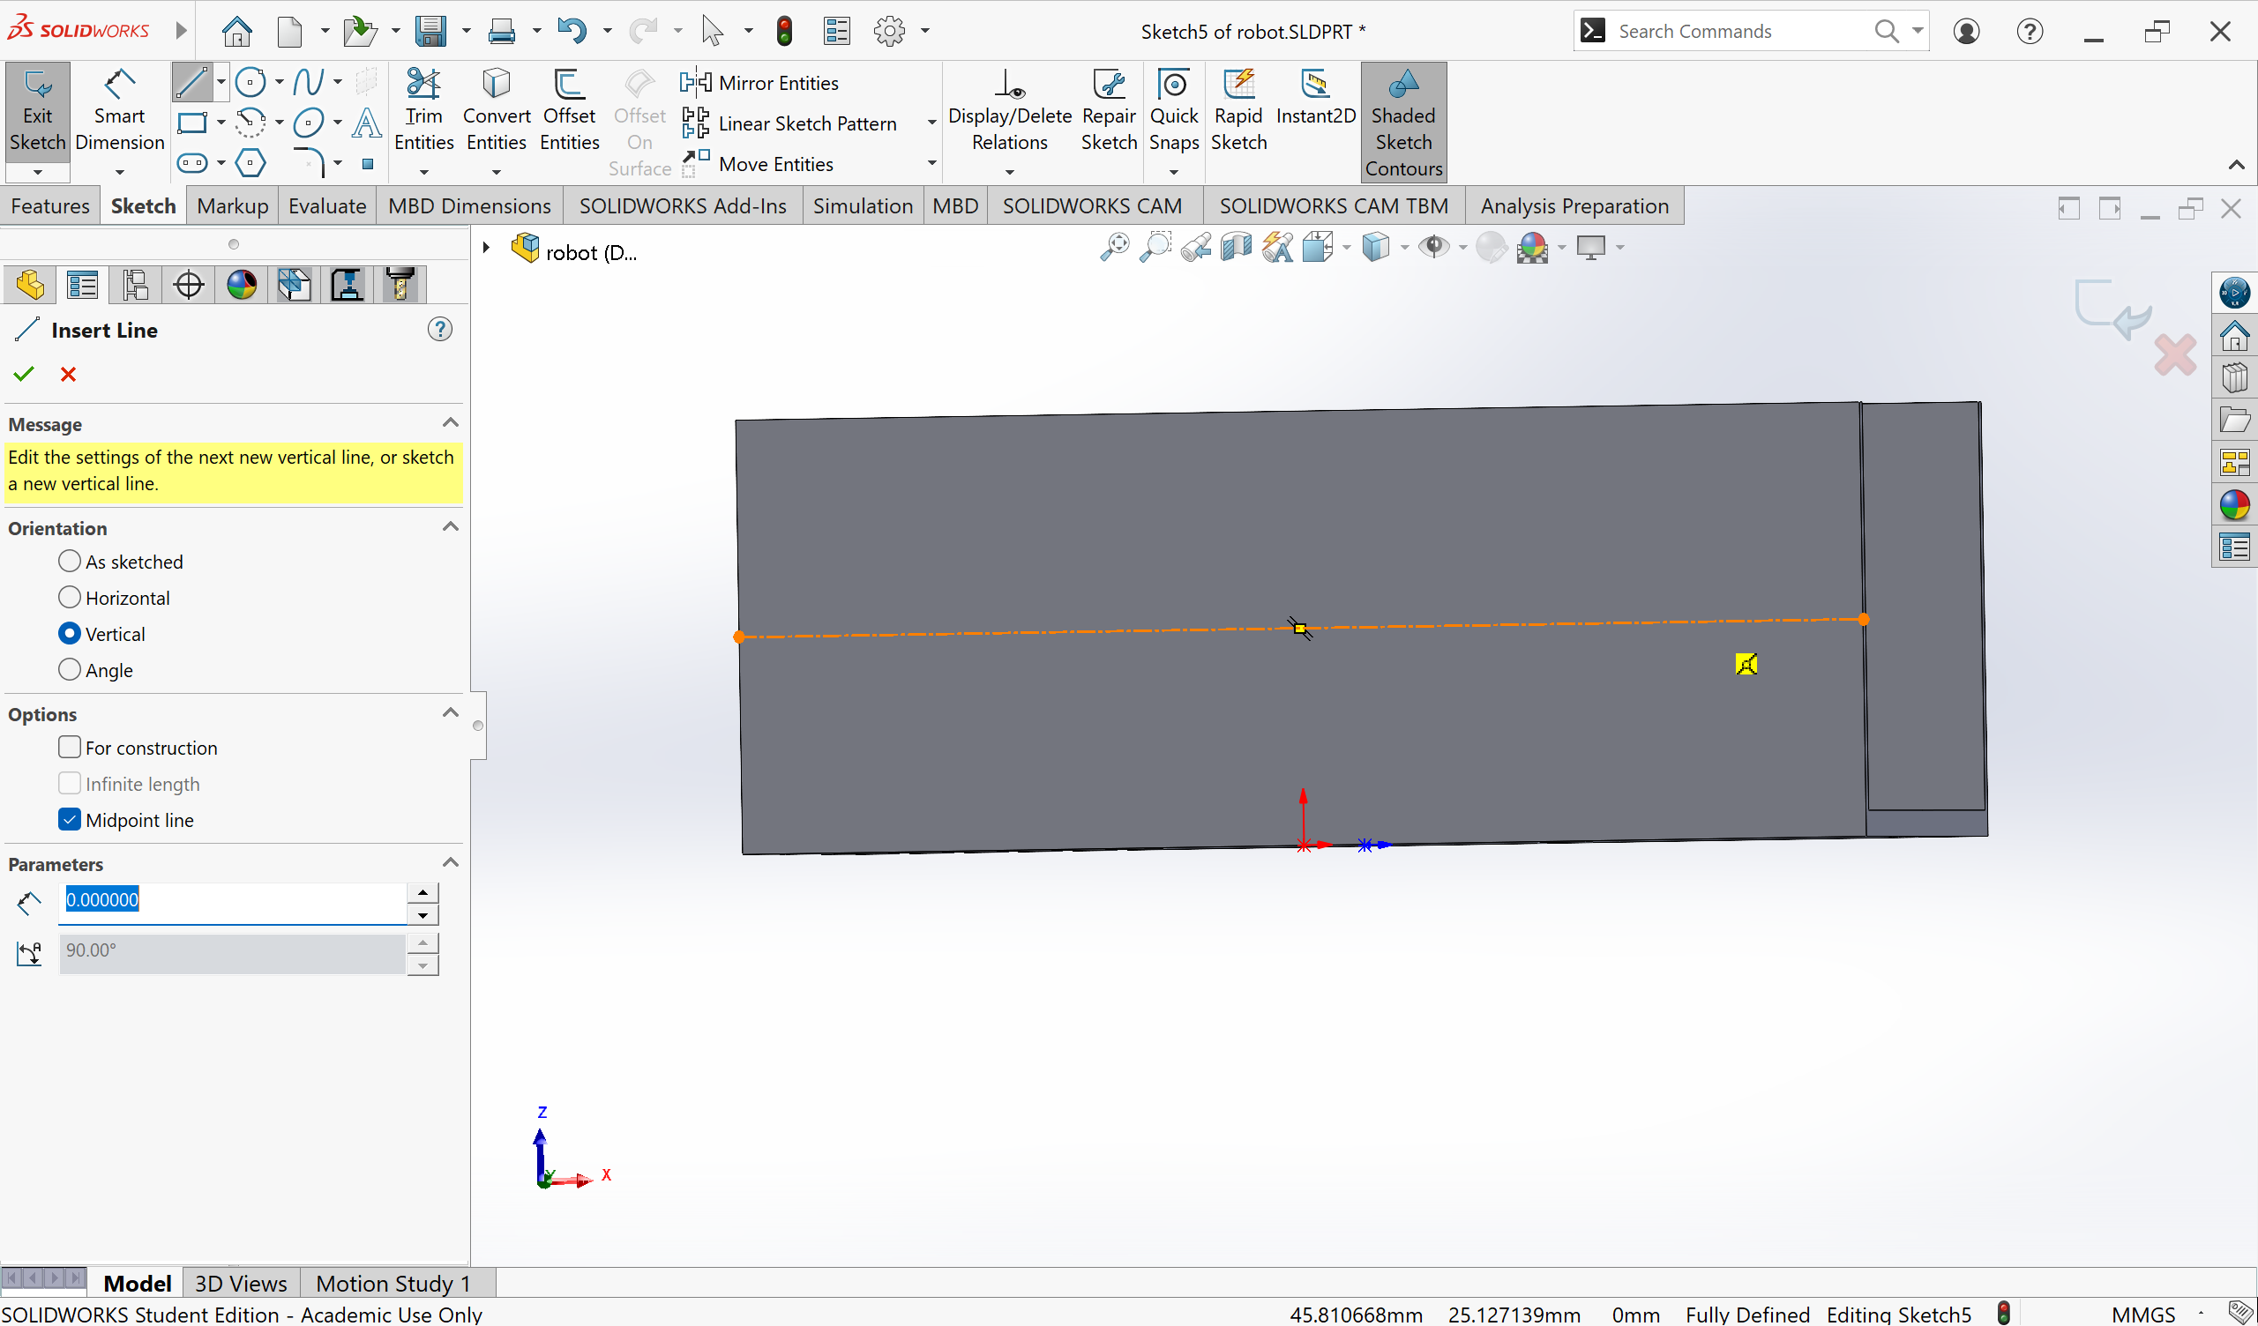
Draw centerline – and construct a vertical line

Slide 24
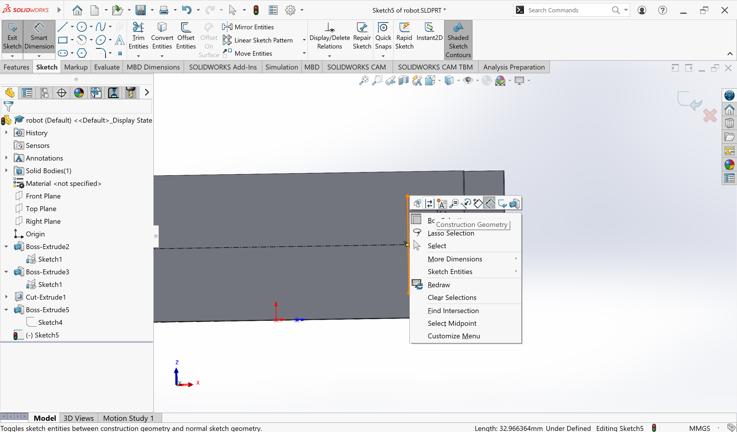
Construction Geometry
Right click the line and switch to construction geometry

Slide 25
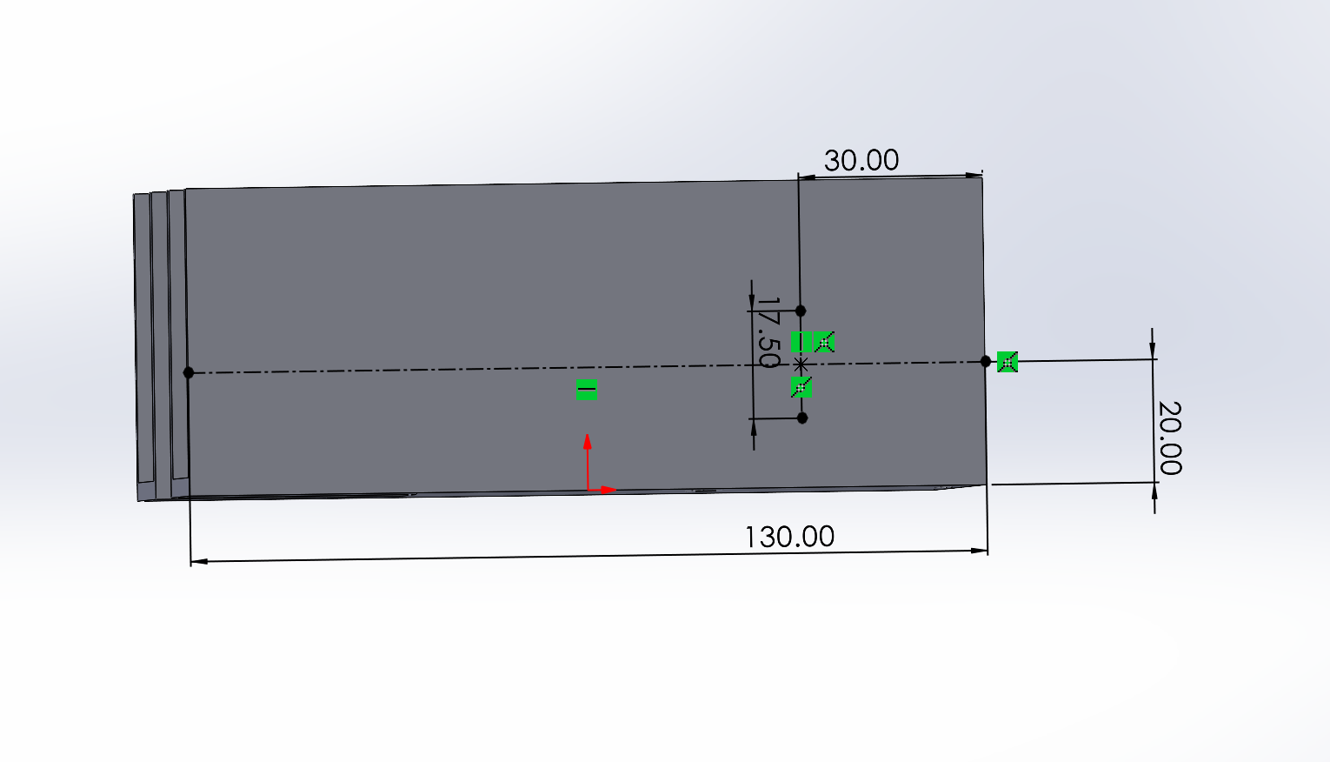
Something like this

Slide 26
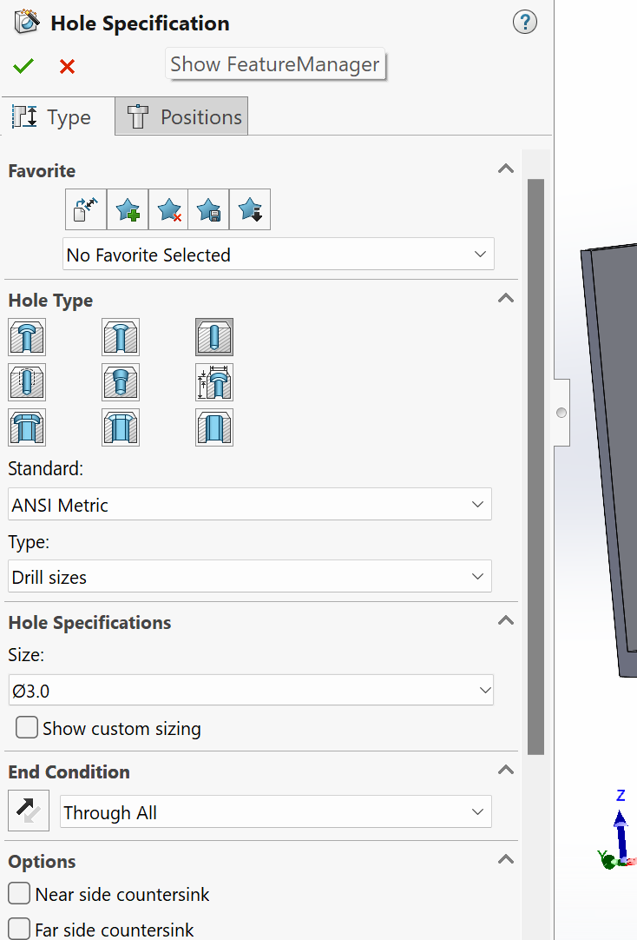
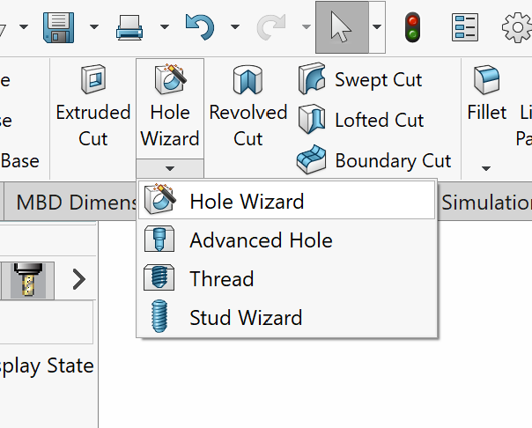
Hole Wizard

Slide 27
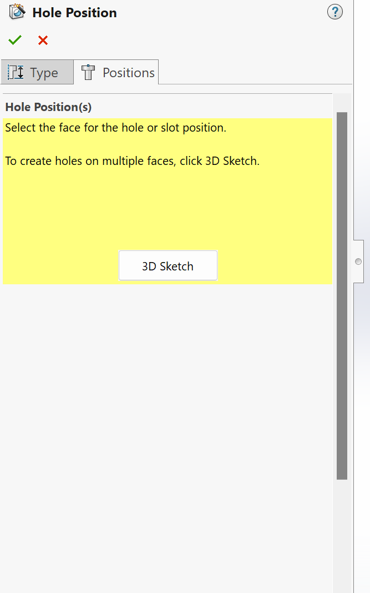
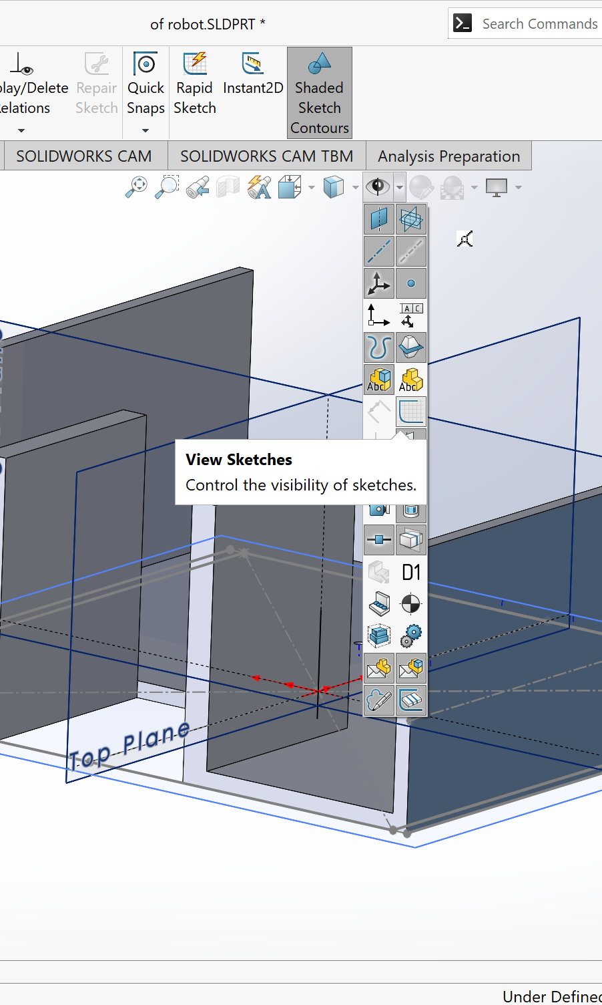
Click 3d sketch If you don’t see your sketch View Sketches

Slide 28
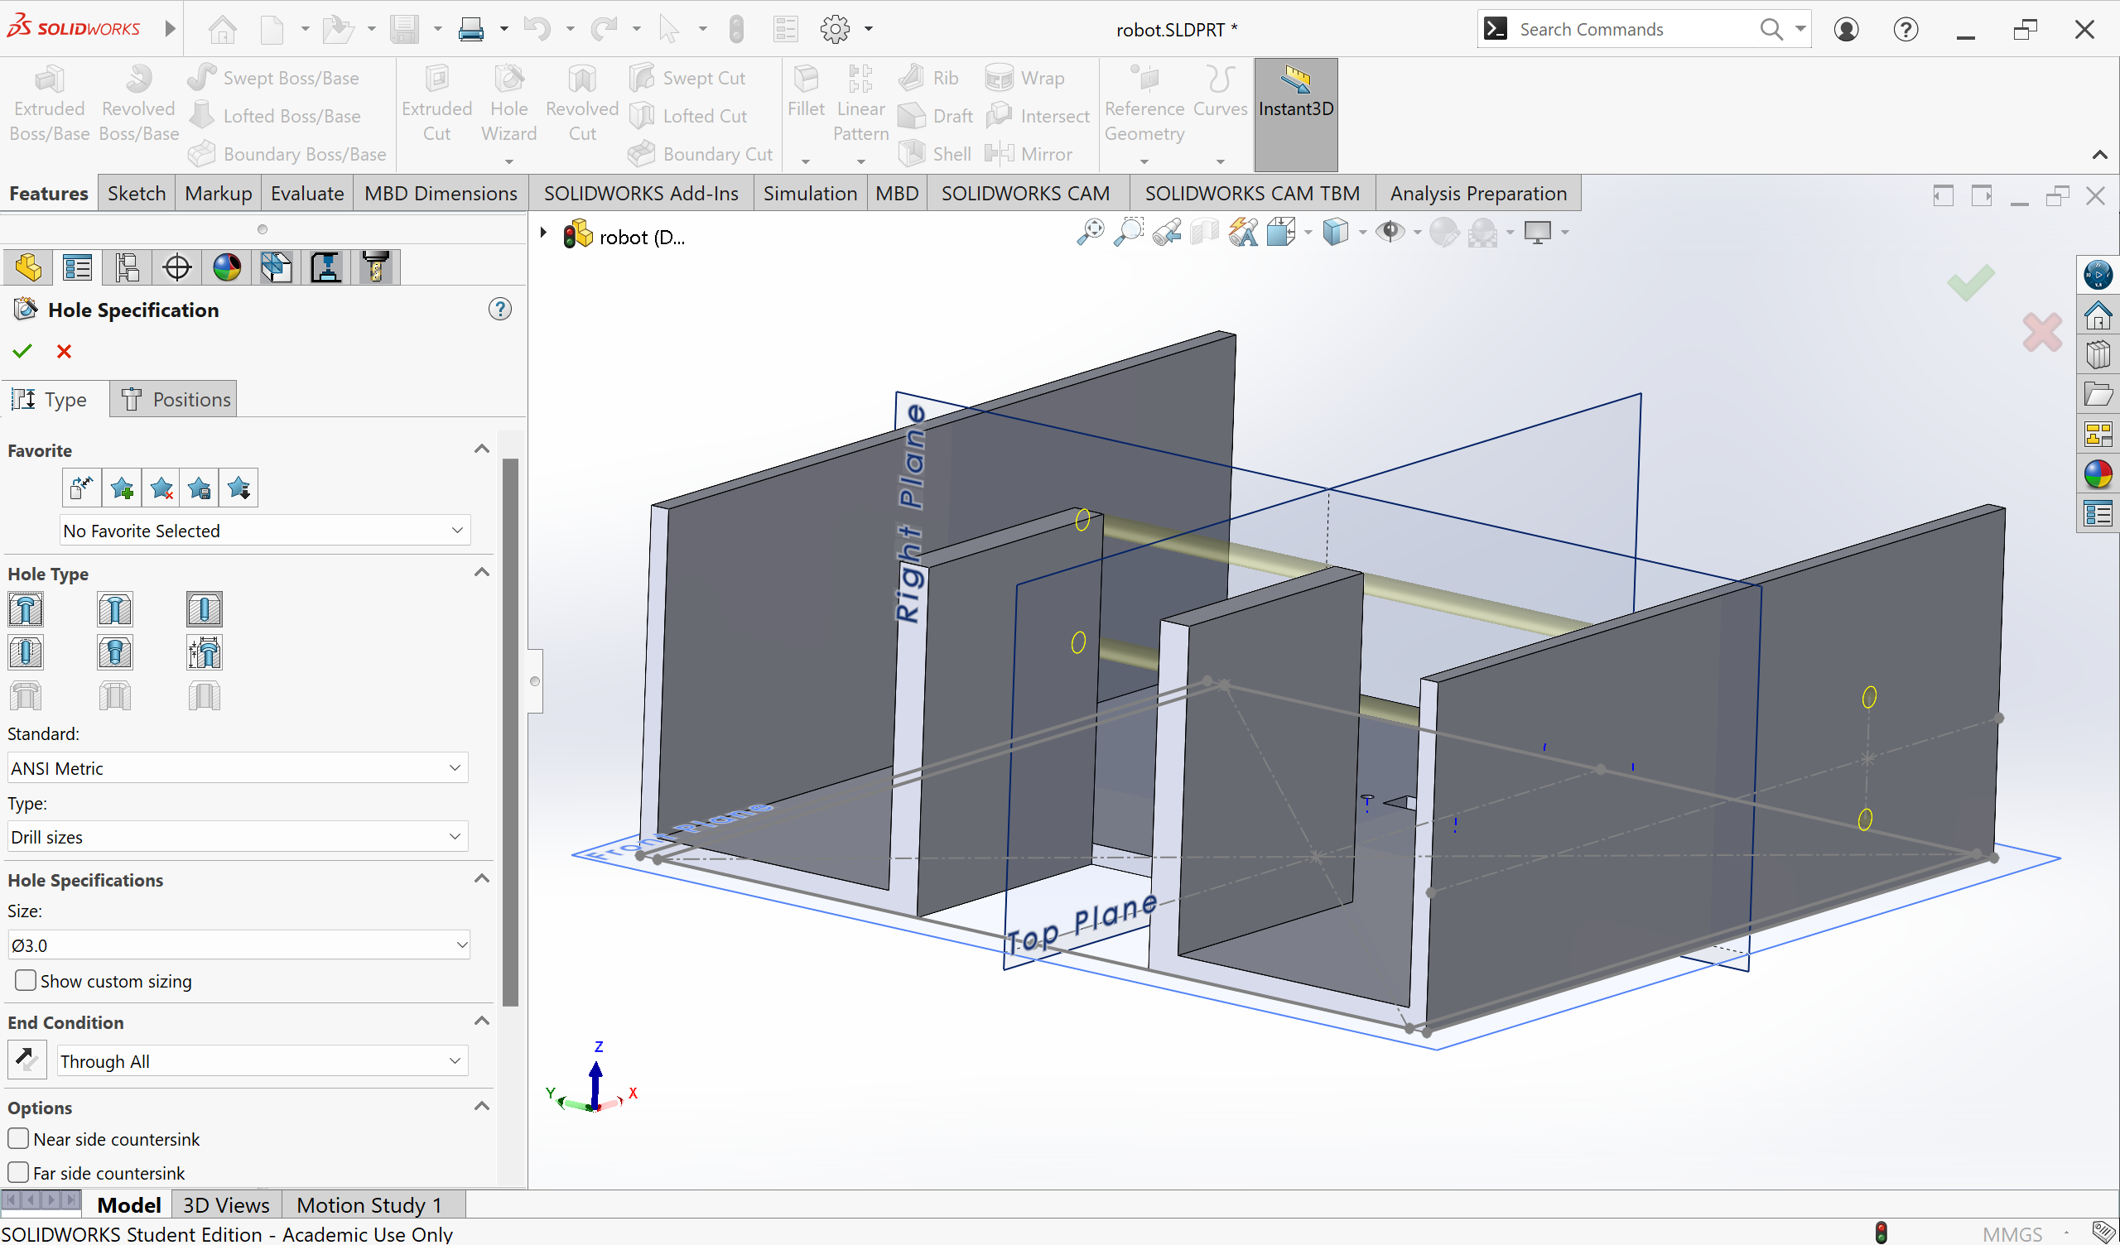

Slide 29
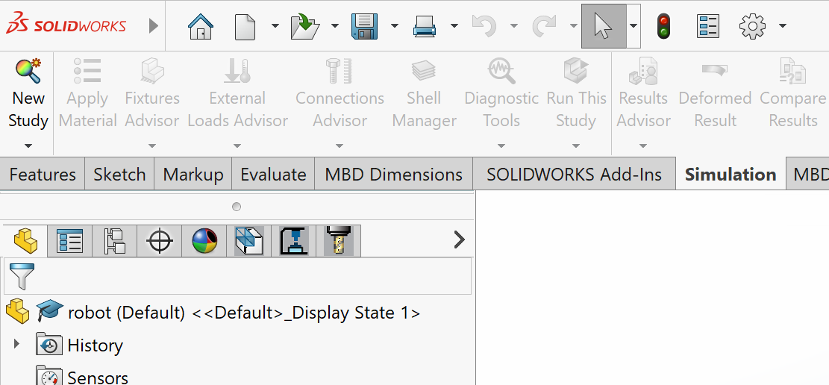
Static simulation – New Study

Slide 30
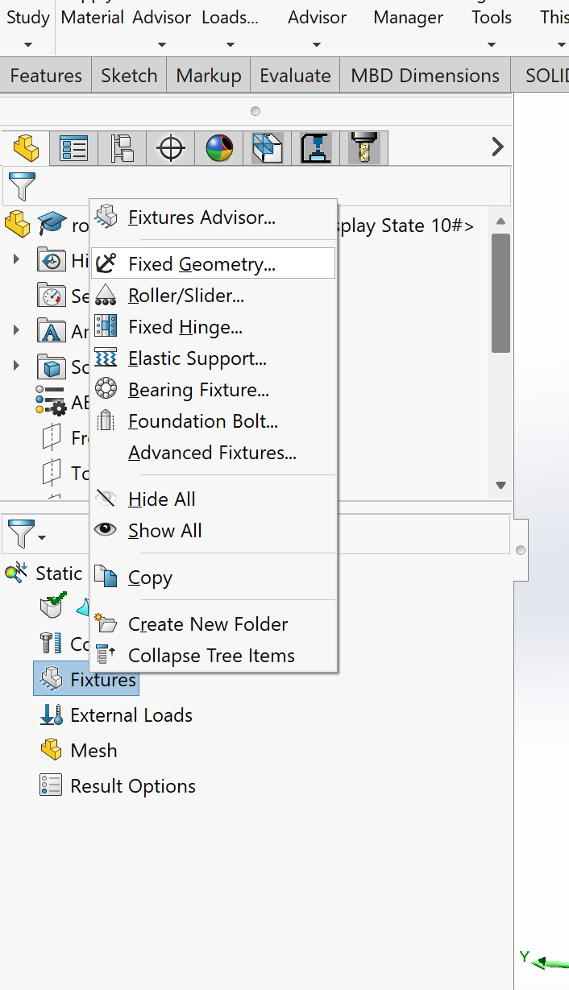
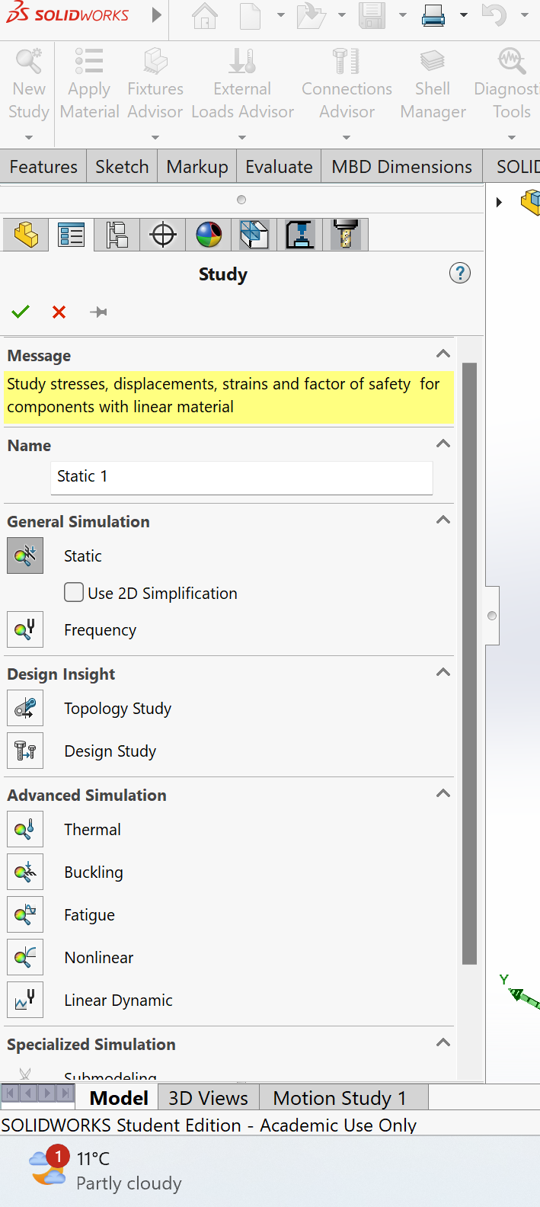
Static Study- Next Fixed geometry

Slide 31
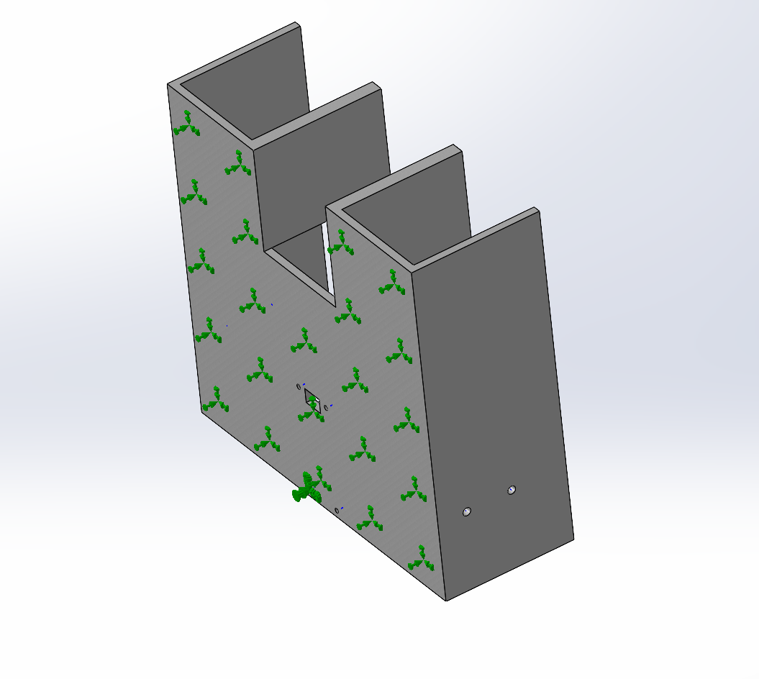
First fix bottom plate

Slide 32
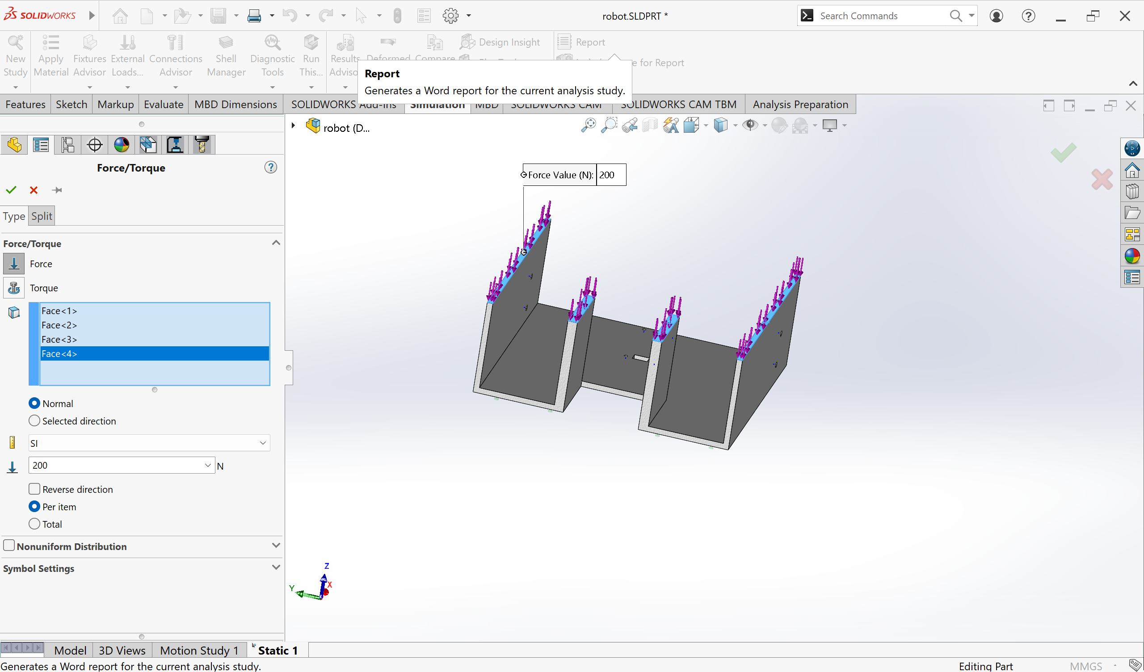
Provide force at the top 200 N

Slide 33

Right click Mesh – Mesh and run

Slide 34

Should get something like this

Slide 35

Now do that for sides

Slide 36

Keep improving by putting rib and rounding edges

Slide 37

Rounding create less stress concentration

Slide 38
Have fun!

